Slide 1
EVENTS WITH YOUTH EXCHANGE

Slide 2
EVENTS WITH THE YOUTH EXCHANGE
18 July 2018

Slide 3
During 16 and 18 of July we had several events shared with the Jordan and Romanians volunteers from Youth Exchange
“INTERCULTURAL NIGHT WELCOME” AND DINNER
ERASMUS PLUS AND EVS PRESENTATIONS
PROJECTS PRESENTATIONS
VIDEO-FORUM ABOUT

Slide 4
INTERCULTURAL NIGHT
We were able to taste typical food of jordan and romania and then we could dance typical dances of each country.

Slide 6
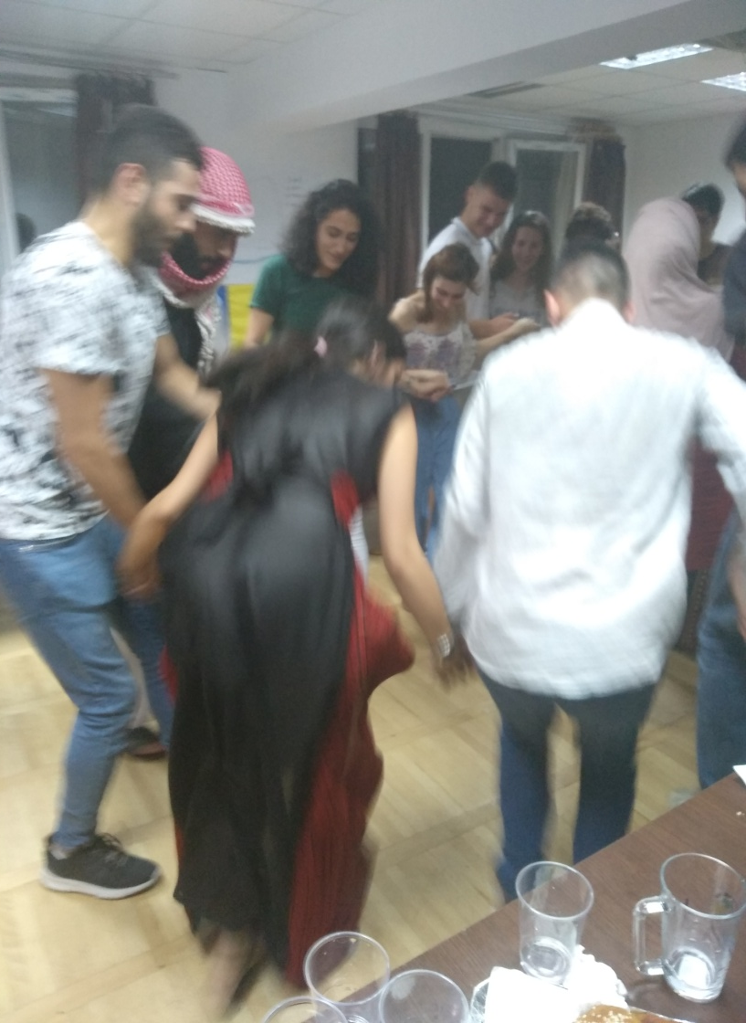

Slide 7
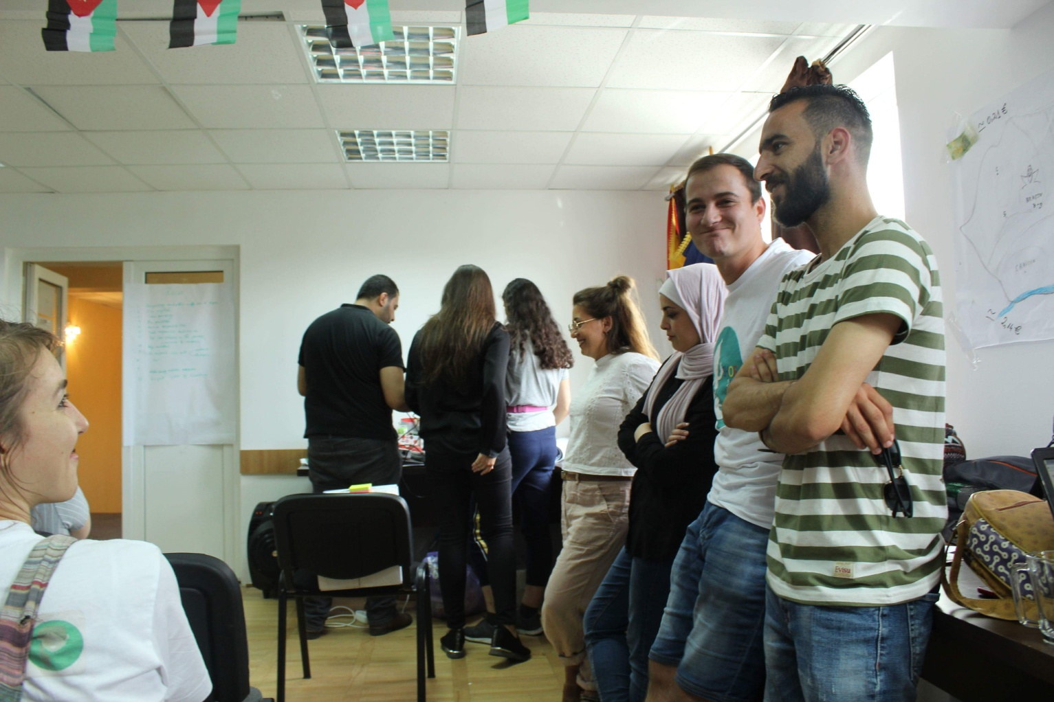
ERASMUS + AND EVS PRESENTATIONS

Slide 8
Teaching the youth exchange the erasmus plus philosophy
The 18 of July in the Griffon Hostel of Craiova this event took place.

Slide 9
ERASMUS + AND EVS PRESENTATIONS

Slide 10
OUR PROJECT: SHOE BOX PROJECT
We tell you the subject, duration, activities and our expectations about our project, as well as the philosophy and the daily life of a volunteer.

Slide 11
SHOE BOX PROJECT PRESENTATION

Slide 12
VIDEO FORUM: Gypsy Child Thieves

Slide 13
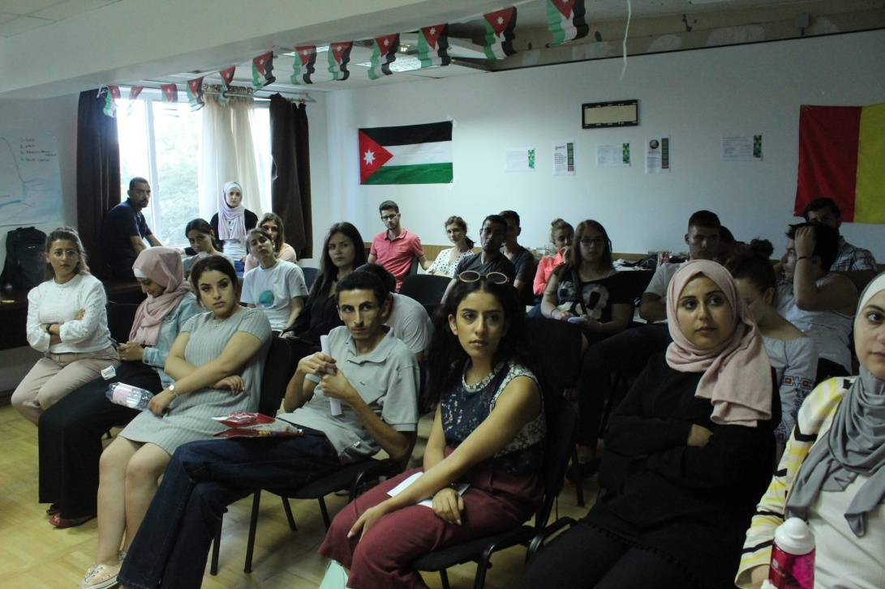
Gypsy Child Thieves
Documentary from 2 September 2009
Director: Liviu Tipurita
Storyline: -Across Europe thousands of young children are being trafficked and forced onto the streets to beg and steal by Romanian Gypsy organized criminal gangs who make millions of Euros by ruthlessly exploiting them.

Slide 14
VIDEO FORUM WITH YOUTH EXCHANGE

Slide 15
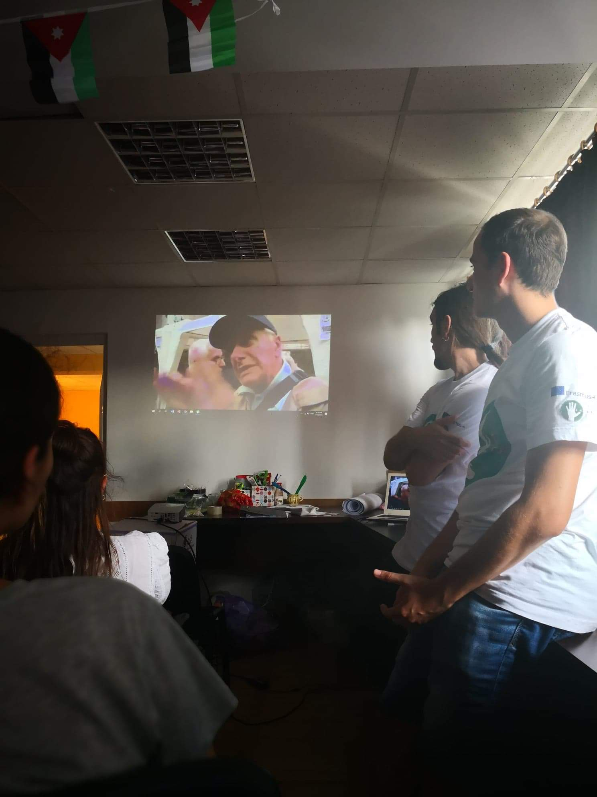
watching the documentary…

Slide 16
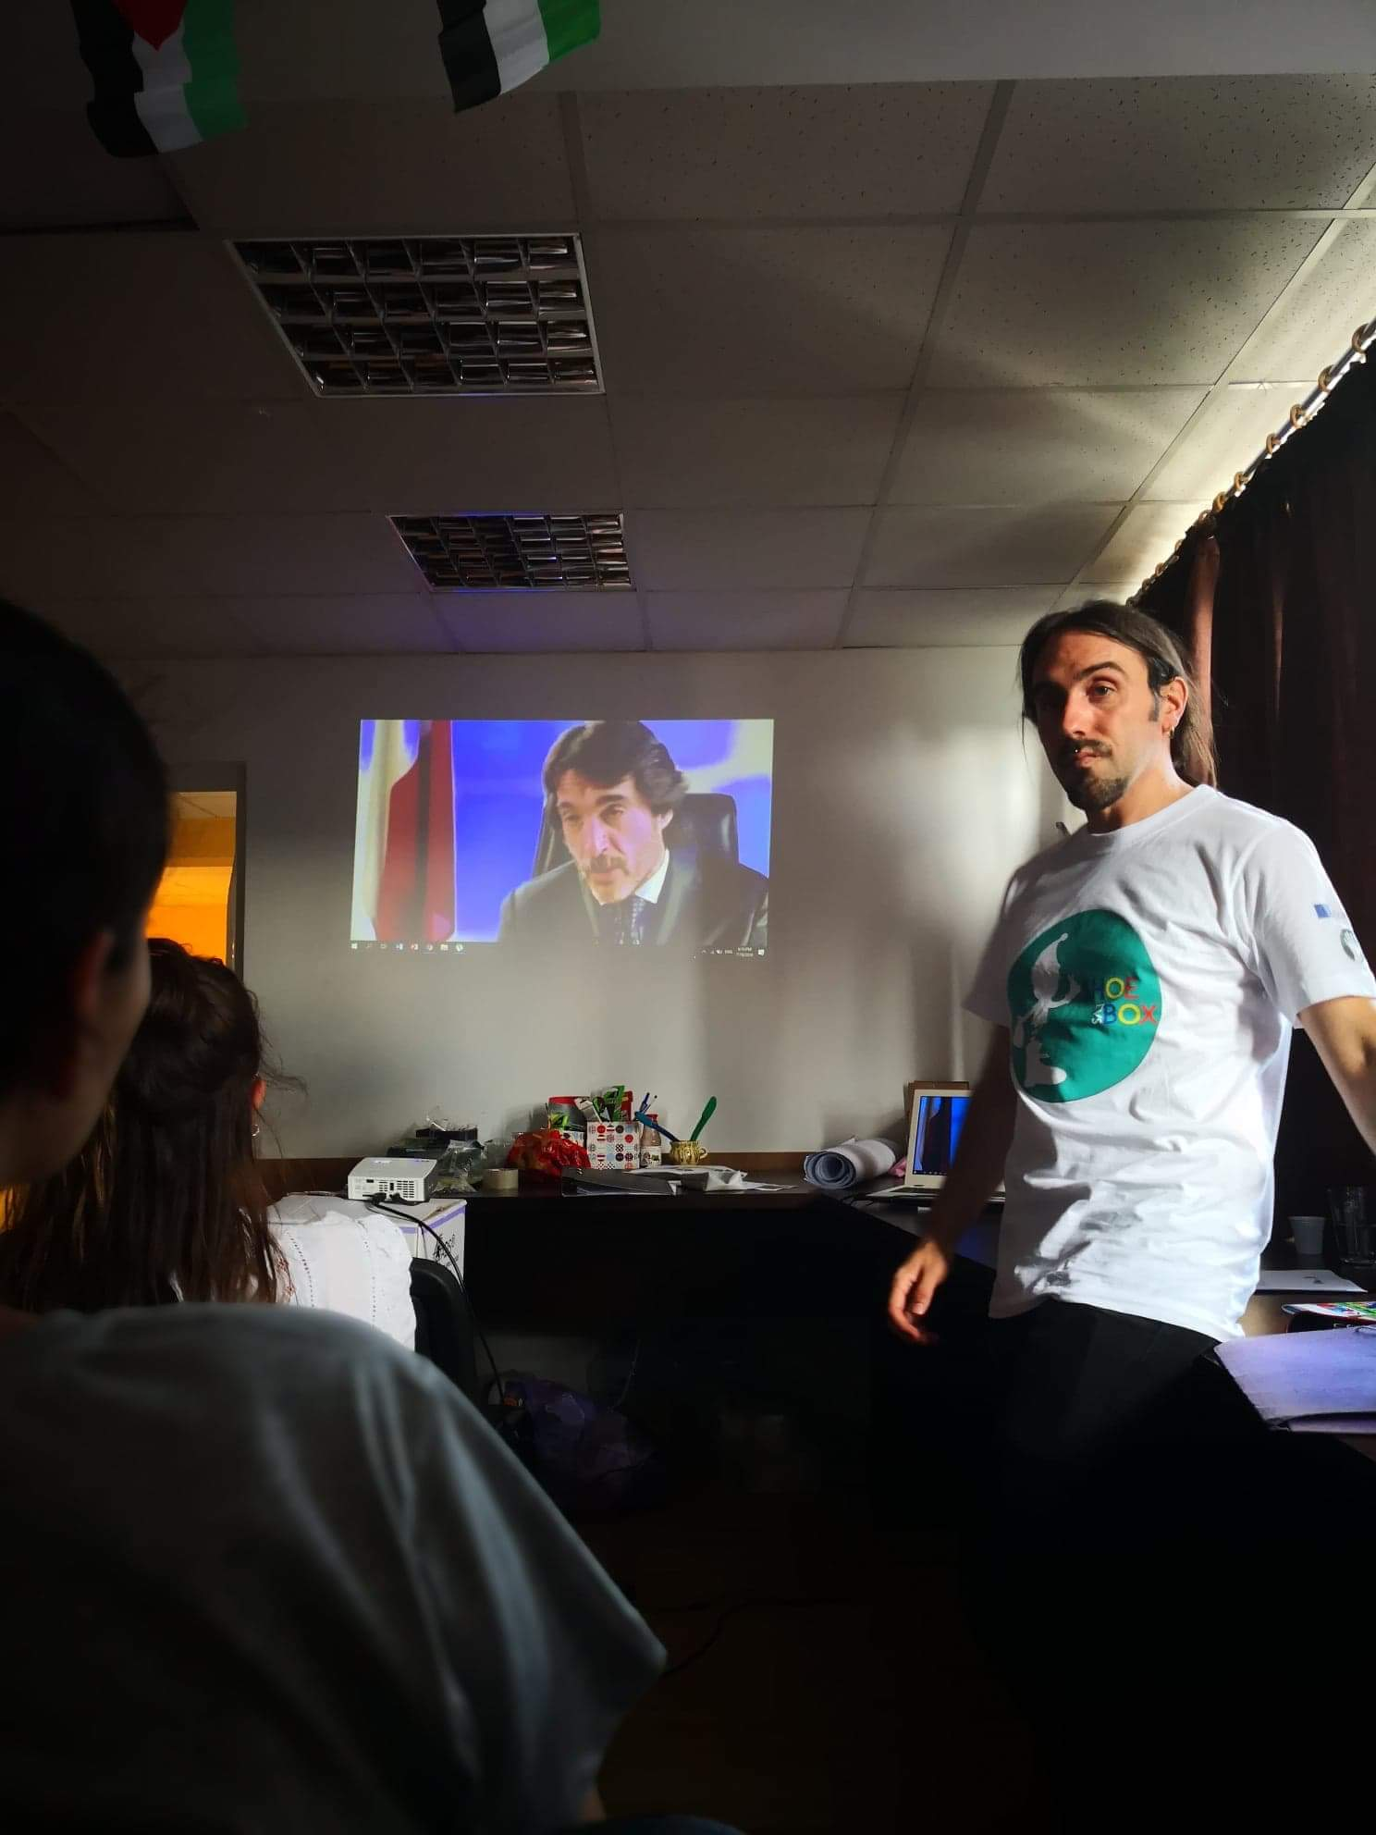
DEBATE AFTER THE DOCUMENTARY
After viewing the documentary we started the debate about the problematic of the gypsy ethnic group. We also try to dismantle the stereotypes that in this ethic we have well established in our thinking

Slide 17
DEBATE AFTER THE DOCUMENTARY

Slide 20
DEBATE ABOUT THE ROMA COMMUNITY

Slide 21
DEBATE AFTER THE DOCUMENTARY

Slide 23
YOUTH EXCHANGE MEETING 18 July 2018
The participation of the members of the youth exchange was very positive so we have to say THANK YOU!

