Slide 1
Children Rights
Photo reportage
Zura Managadze

Slide 2
We asked romanian people what they know about children rights.

Slide 3
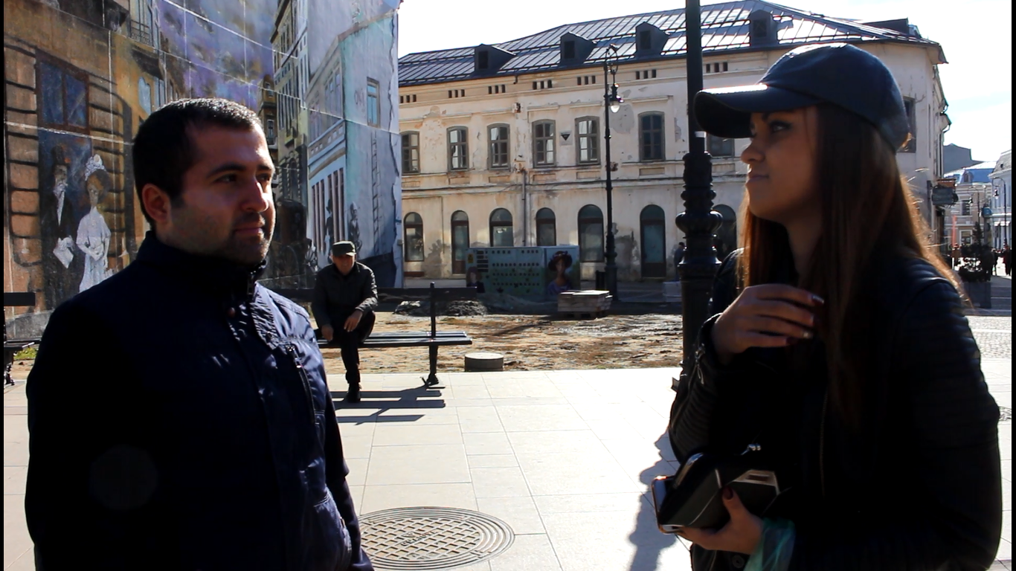

Slide 4
Silent action about children rights

Slide 5
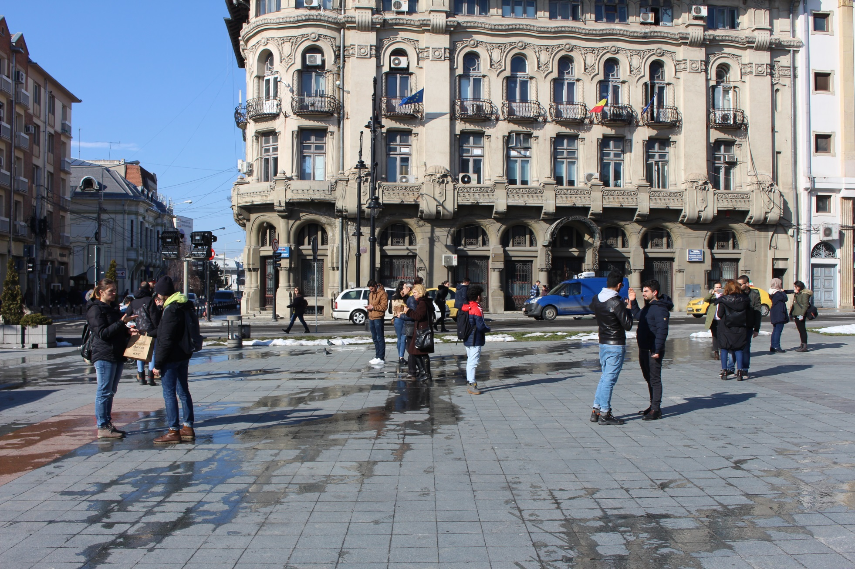
Do you want to know more about children rights?

Slide 6
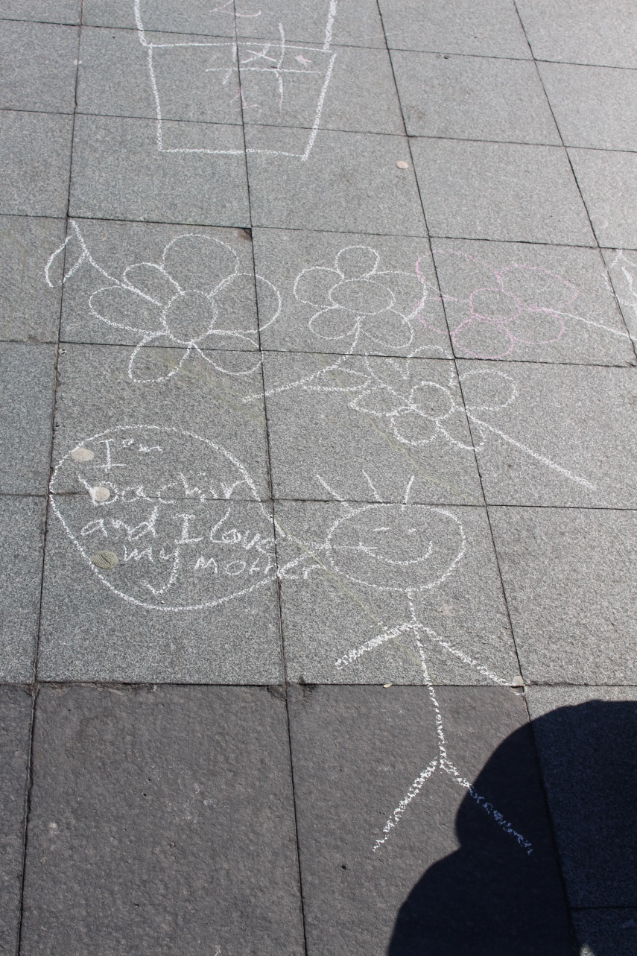
The right to play

Slide 7
Right for talk

Slide 8
Right for education

Slide 9
Right to health

Slide 10
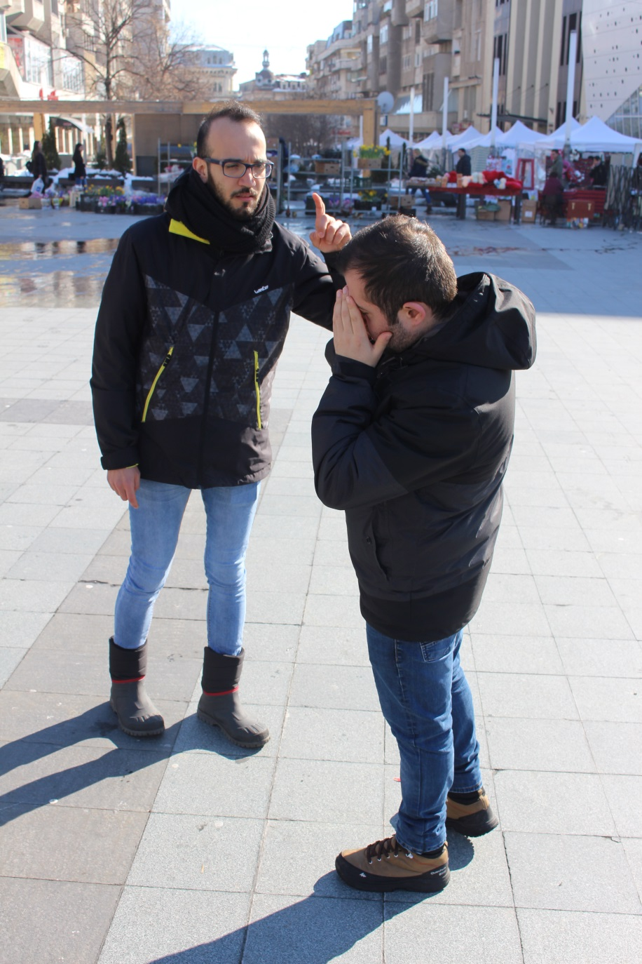
Right to love and family life

Slide 11
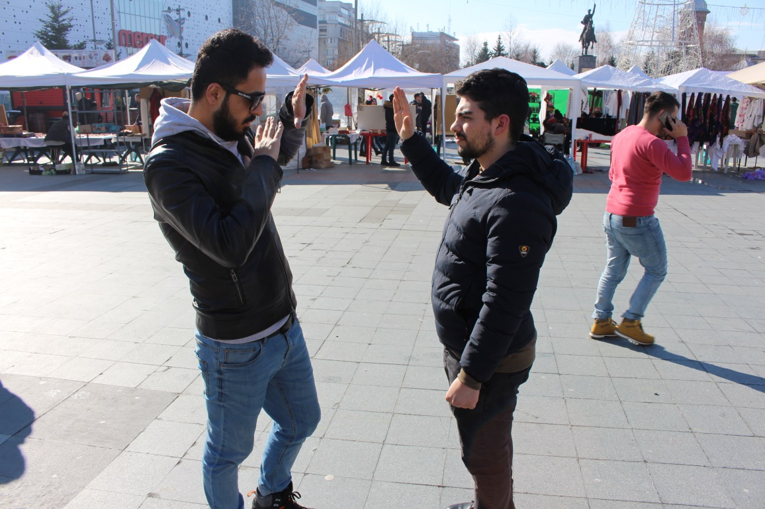
Right to be protected from abuse and harm

Slide 12
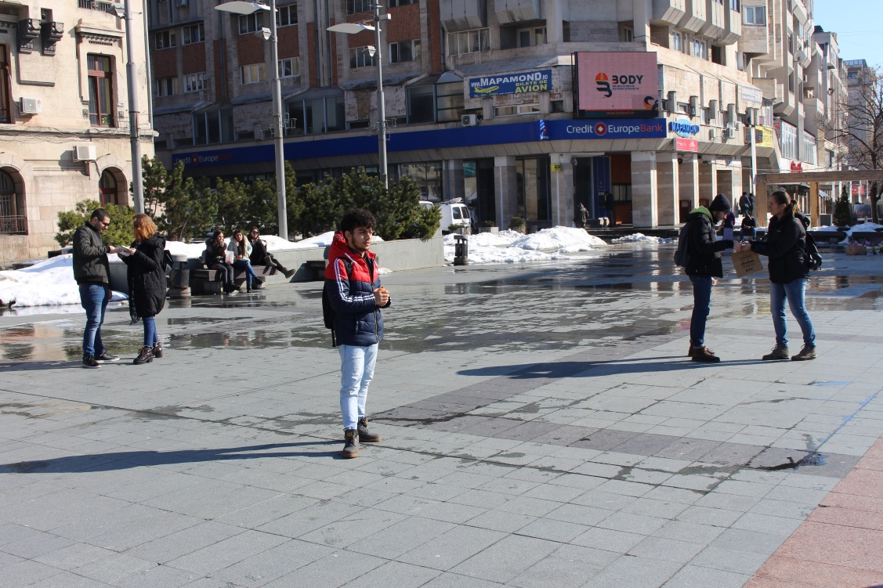
Preparing for the event

Slide 13
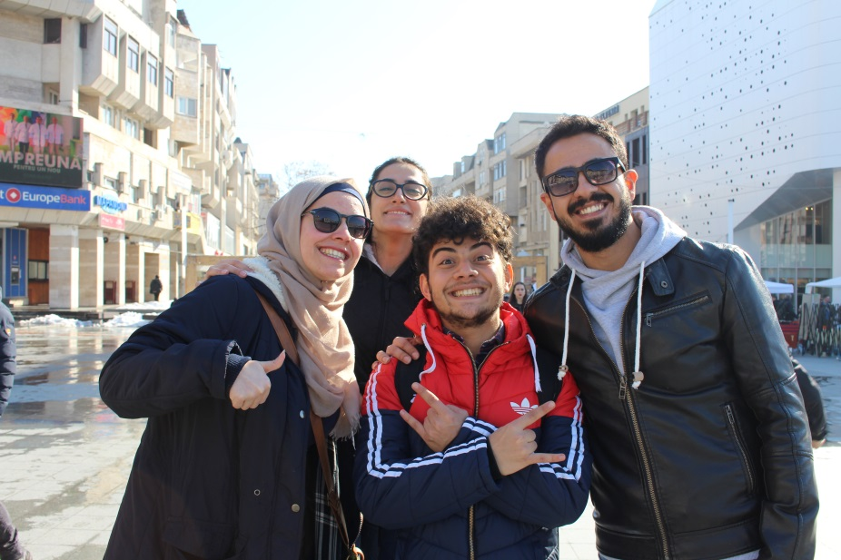
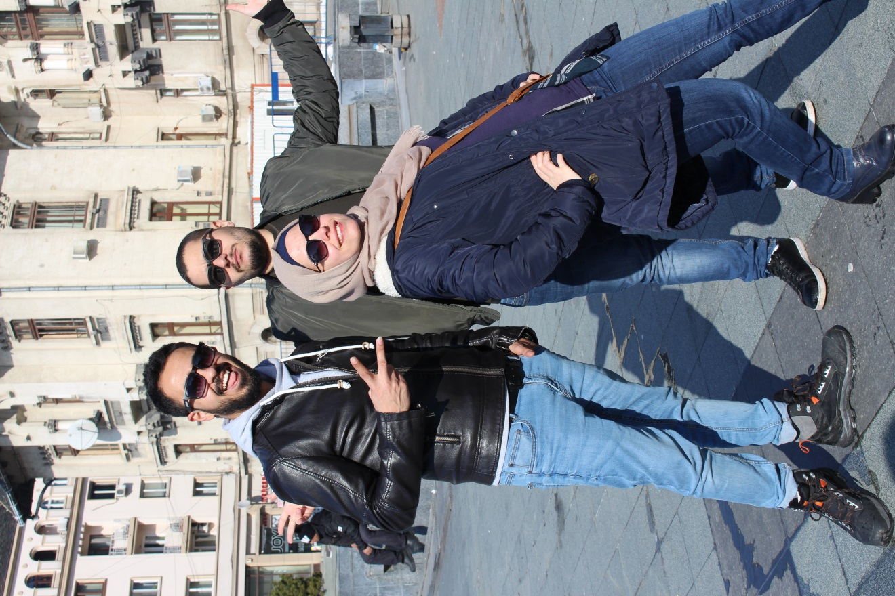
Chilling before the Silent action

Slide 14
Mulțumesc
Funded by the European Commission (European Union) through Erasmus+ program

