Slide 1
Birthday Donation
Photo reportage

Slide 2
Our first Birthday donation

Slide 3
We are on our way to our birthday boy

Slide 4
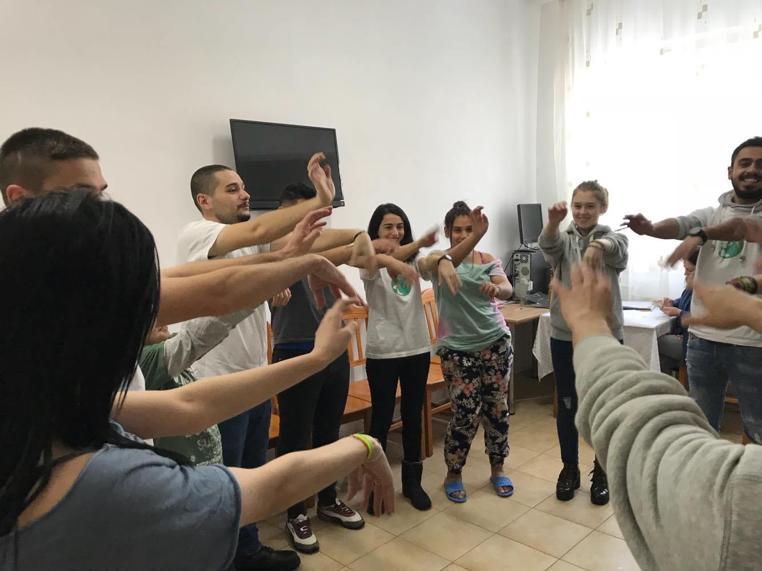
We are getting to know each other with the games

Slide 5
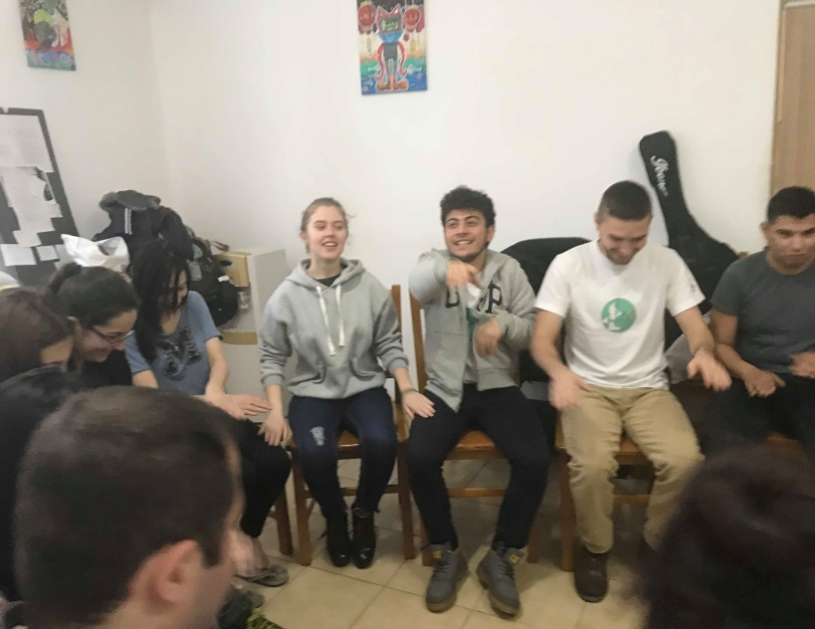
We have a lot of games prepared

Slide 6
Have you ever tried to draw with both hands?

Slide 7
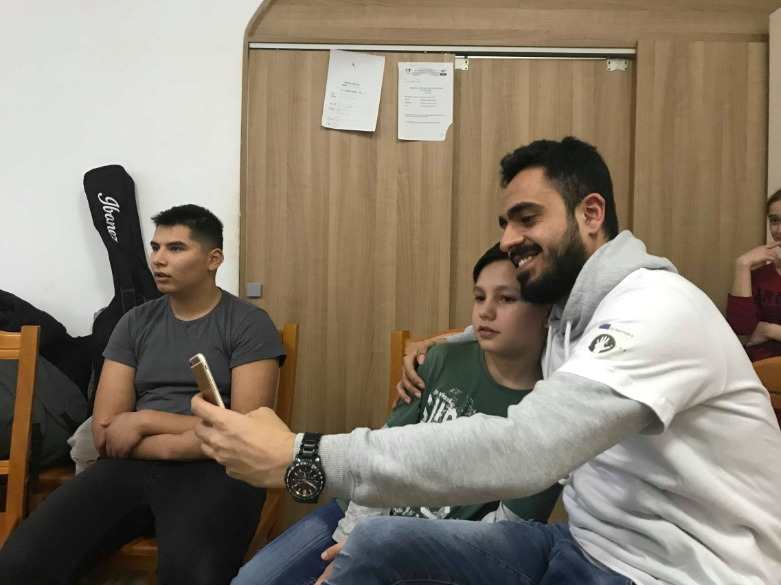
Selphy
Time

Slide 8
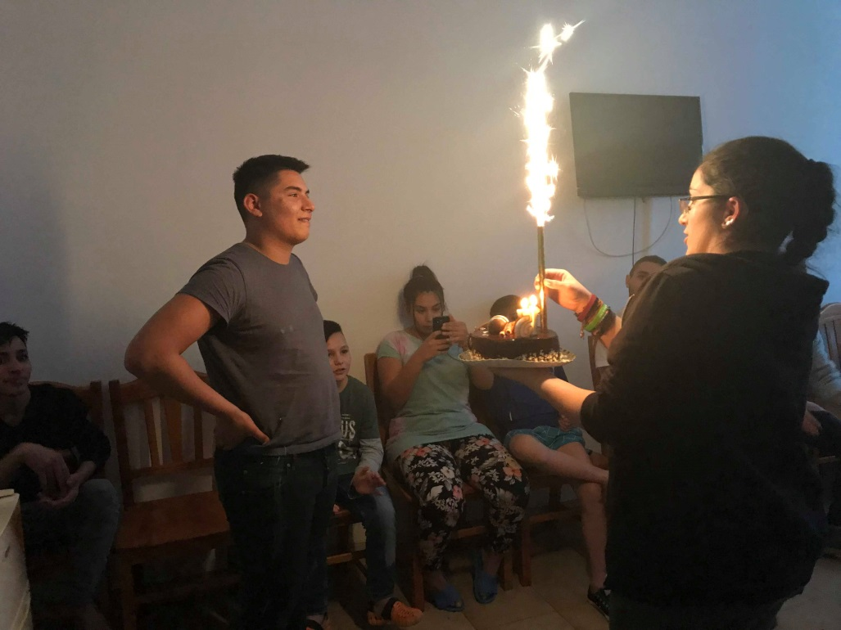
And finally
Time for cake

Slide 9
And of course final selphy

Slide 10
Silent action about Birthday donation

Slide 11
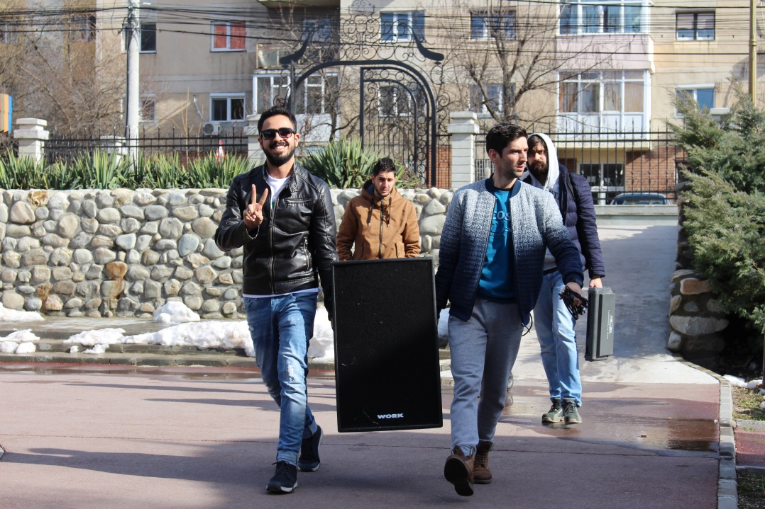
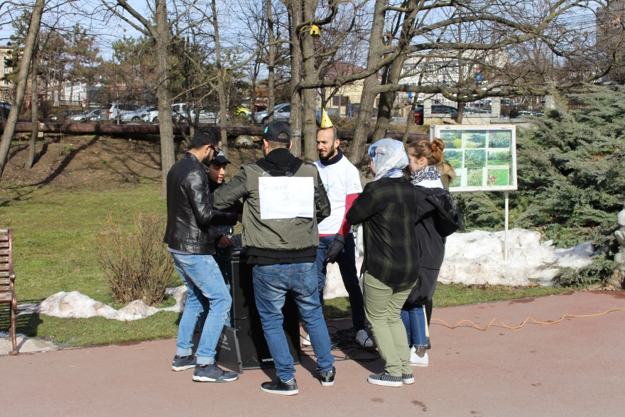
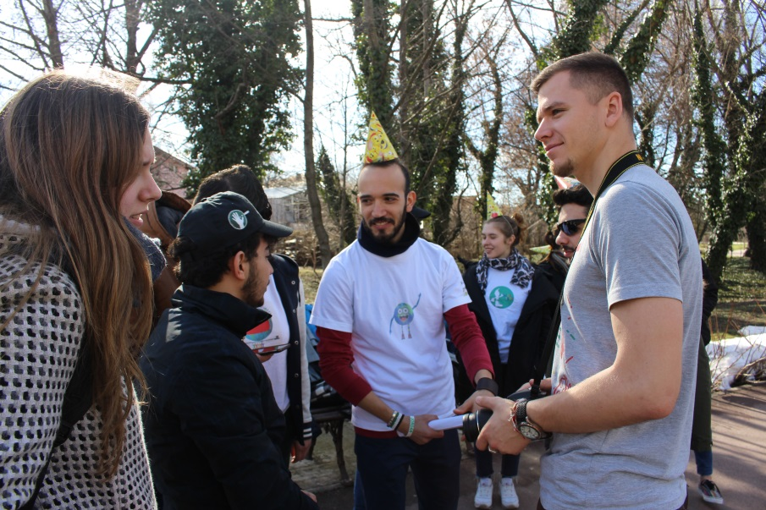
Preparation

Slide 12
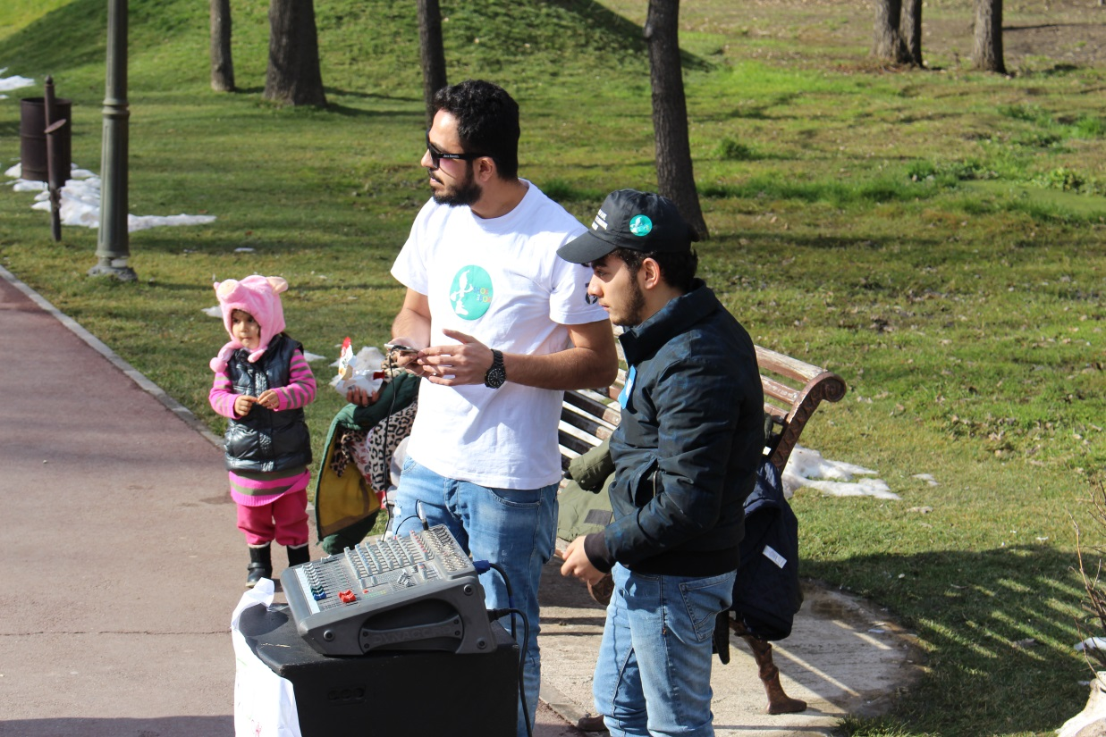
Our
Dj

Slide 13
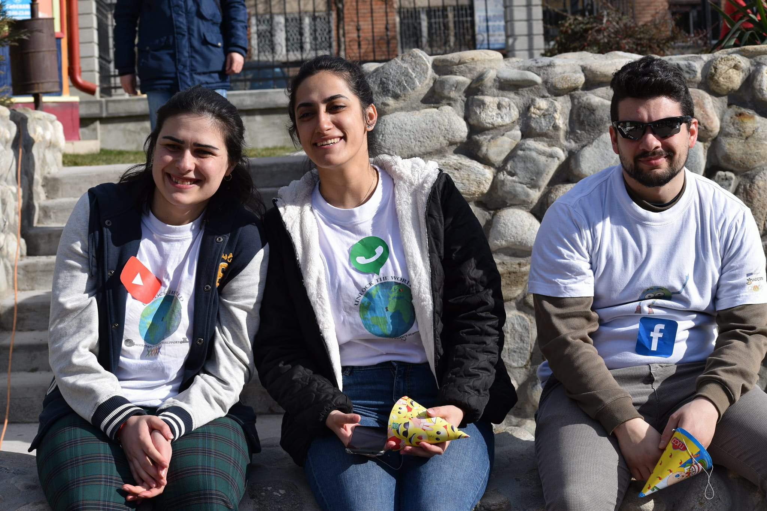
Social Media
Crew

Slide 14
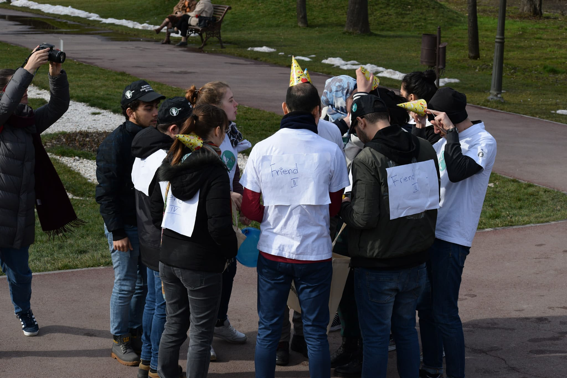
Friends are preparing gifts

Slide 15
Everyone is happy!

Slide 16
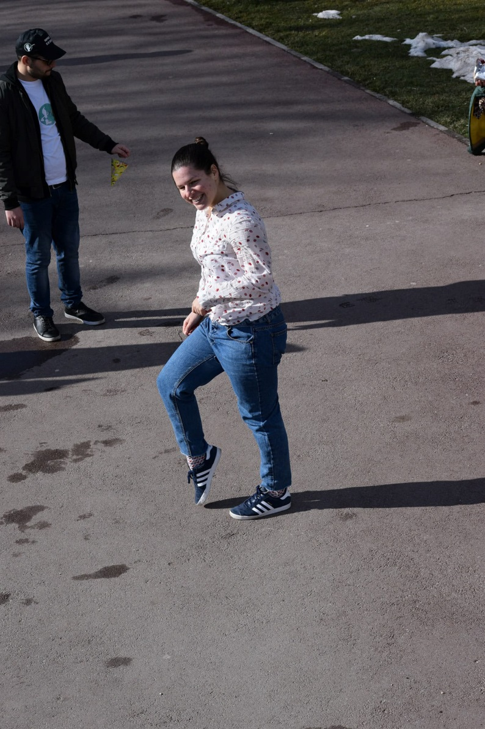
Best dancer ever

Slide 17
Final Picture Together

Slide 18
Together we can change the world

Slide 19
Tamari Samkharadze 2018
The End…
Funded by the European Commission (European Union) through Erasmus+ program

