Slide 2
Craiova

Slide 3
Place to Visit in Craiova
Musical Fourtion
English Park
Alexandru Loan Cuza
Barbu Ştirbei
Botanical Garden
Nicola Romanescu Park
Bust of Nicolae P. Romenescu
Monumentul Indpendentei
Art Museum
Parc Teatru
Carol I Statue

Slide 4
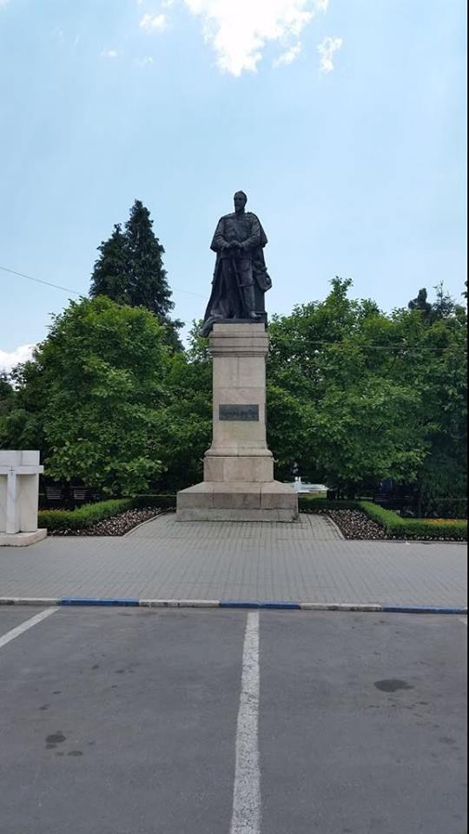
English Park
English Park in Craiova, a real oasis in the city center was set up in the interwar period. It was part of a project in that was built also the White House, the first block of flats of Craiova. English Park is an English style garden, the work of architect Constantin Iotzu
Alexandru loan Cuza
Cuza's reforms also included the adoption of the Criminal Code and the Civil Code based on the Napoleonic code (1864), a Law on Education, establishing tuition-free, compulsory public education for primary schools (1864; the system, nonetheless, suffered from drastic shortages in allocated funds; illiteracy was eradicated about 100 years later, during the communist regime).

Slide 5
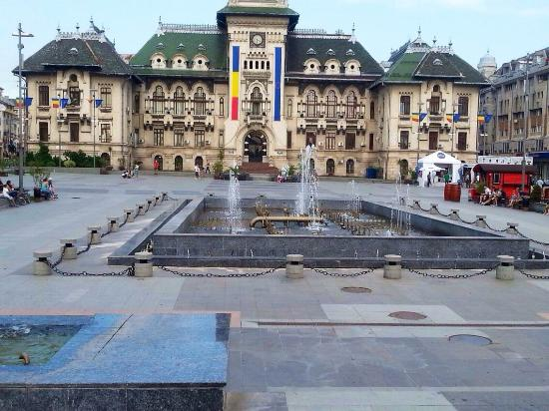
Barbu Ştirbei
After Wallachia was occupied by Imperial Russia following the Russo-Turkish War of 1828–1829, general Pavel Kiseleff promoted him to the central government, where he served as president of the Wallachian commission charged with drafting the Organic Regulation
Musical Fountain
A musical fountain, also known as a dancing fountain, is a type of animated fountain for entertainment purposes that creates an aesthetic design (including three-dimensional images).

Slide 6
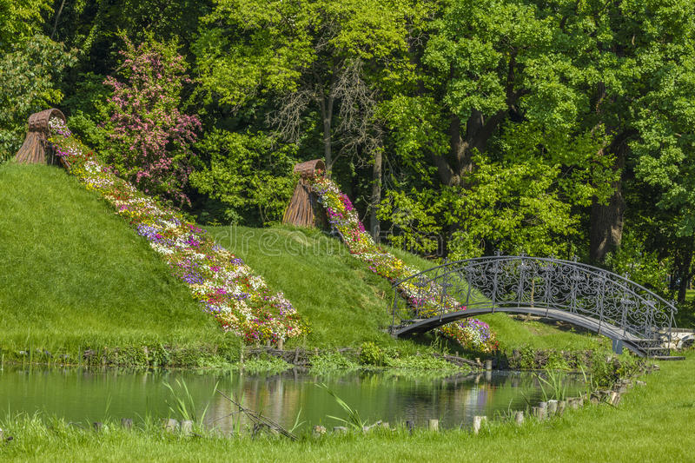
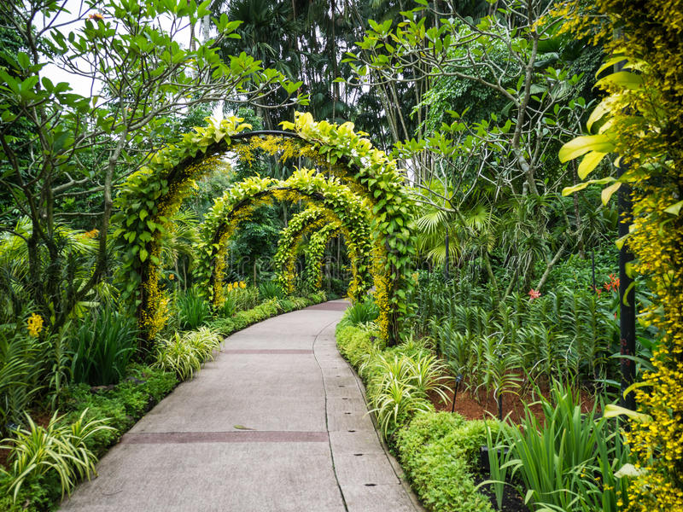
Craiova Botanical Garden
Craiova Industrial Park represents an important investments objective that is built at Craiova Aircraft Enterprise, covering an area of over 18.30 hectares:
8.03 hectares, demised to the Dolj County by the Romanian Government in order to build Craiova Industrial Park

Slide 7
The Charmed Castle was built near the Romanescu Park Suspended Bridge, shortly after its inauguration. During the communist years, the building was transformed into a restaurant, and after the Revolution it functioned as a bar.
Built in a romantic style, the Castle has an area of ​​nearly 110 square meters and has once been a landmark for Craioveans and tourists. The ruins of the castle have long become a tourist attraction.
Castelul Fermecat Craiova

Slide 8
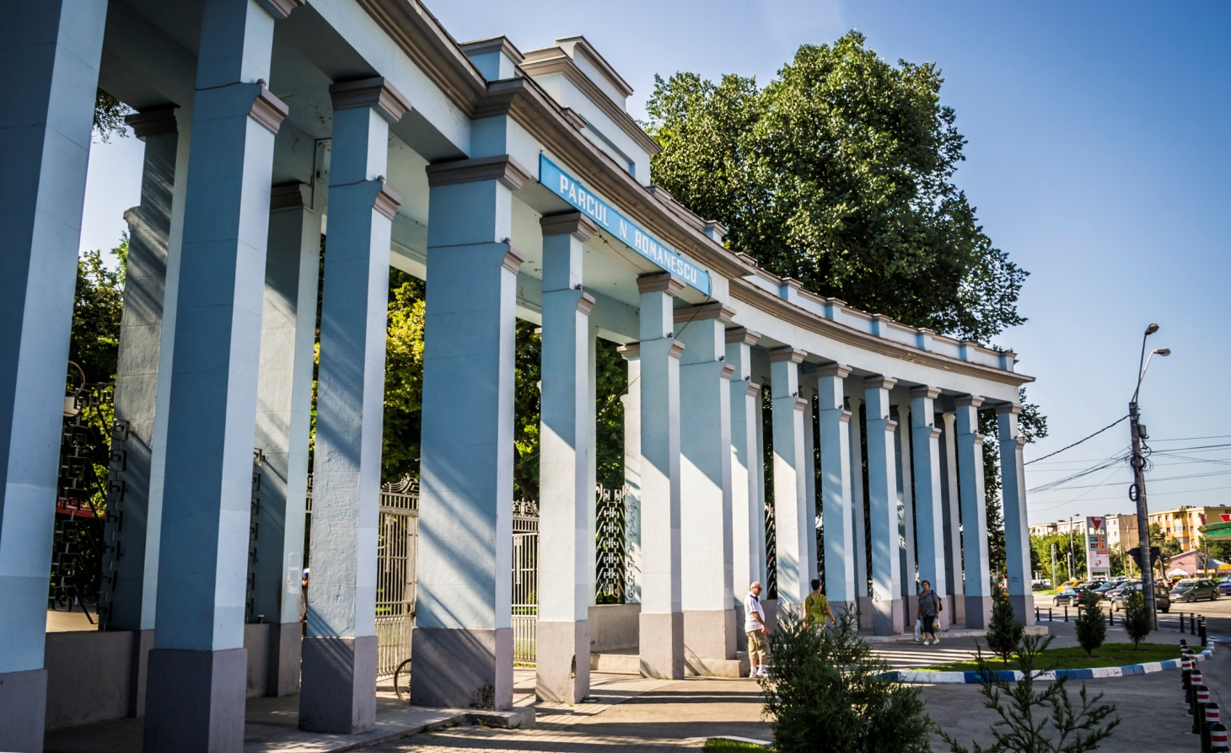
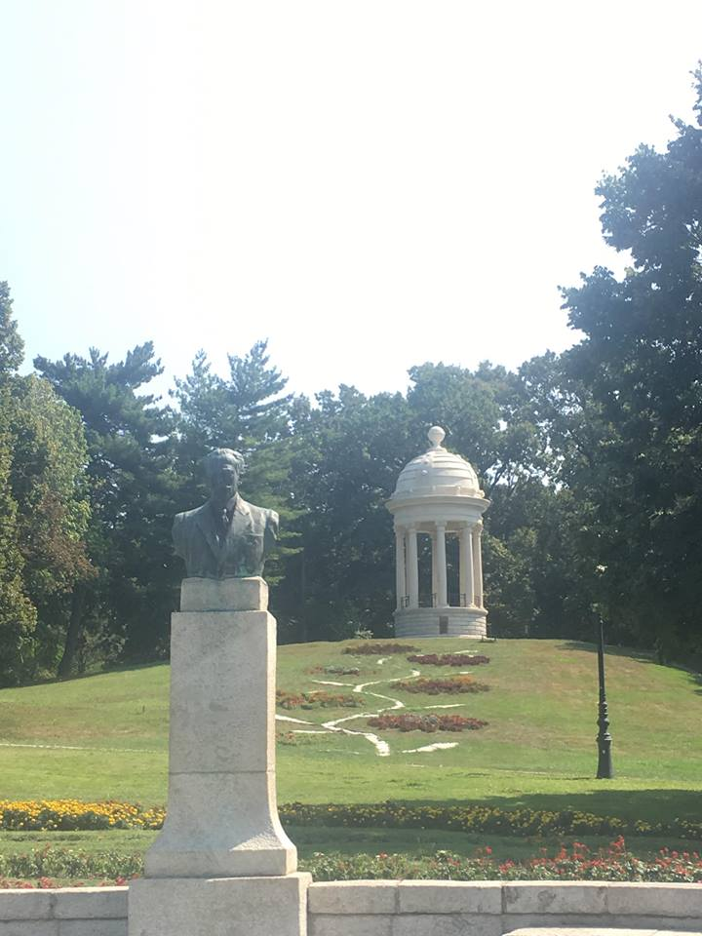
Nicolae Romanescu Park
Nicolae Romanescu Park (Romanian: Parcul Nicolae Romanescu) is a park in Craiova, Romania. It was designed by the French architect Édouard Redont and constructed between 1901 and 1903. It is considered the largest natural park in eastern Europe.[citation needed] It has an area of around 23 acres (9.3 ha) and the area of the lake within the park is about 10 acres (4.0 ha).
Bust Romanescuof Nicolae P.

Slide 9
Art Museum Craiova
The museum was founded in 1954. It is the main art museum in Craiova and is a significant tourist attraction for the city. A major attraction of the museum is the gallery dedicated to Constantin Brâncuși, exhibiting six of his early sculptures (including variants of his best-known works): Vitellius (1898), Miss Pogany (1902), The Vainglory (1905), Boy's Head (1906), The Kiss (1907), and Woman Torso (1909). It also has a variety of paintings by important Romanian masters such as Theodor Aman, Nicolae Grigorescu, Vasile Popescu, Ștefan Luchian, and Theodor Pallady, together with some Romanian icons.

Slide 10
Parc Teatru
The National Theater building in Craiova
Marin Sorescu National Theater Craiova , formerly known as the National Theater in Craiova , is a public theater culture institution funded by the Ministry of Culture and National Patrimony. Founded in 1850 , the theater was named after the culture man and local writer Marin Sorescu in the years after the 1989 Revolution . The current building of the Craiova Theater, a real architectural symbol of the city, created by the architect Alexandru Iotzu , was inaugurated in 1973 .

Slide 11
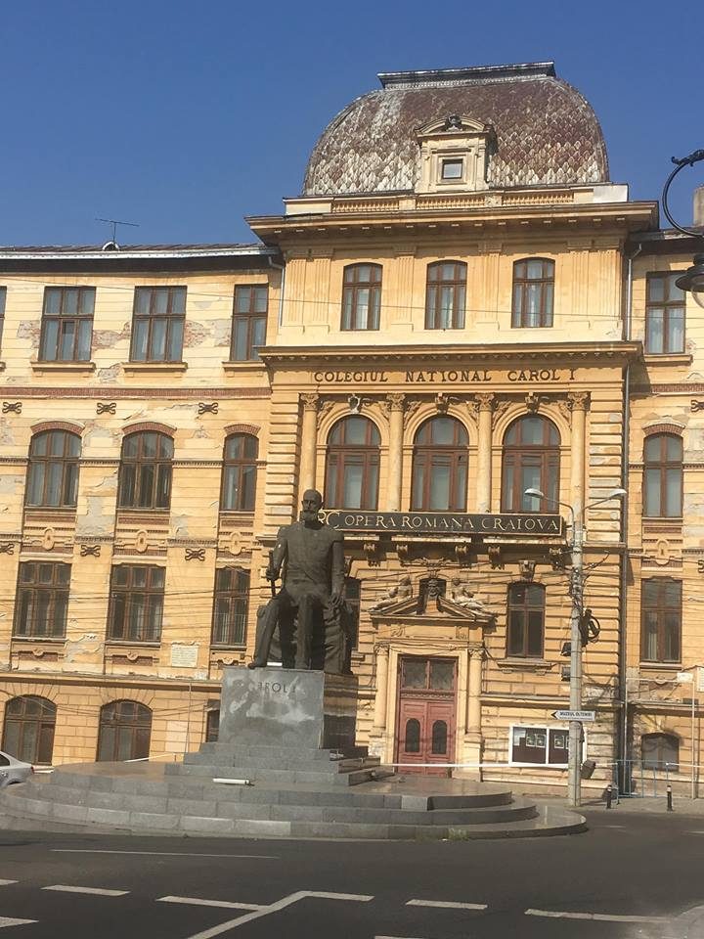
OperaCarol I
Carol I" National College is an educational institution in Craiova , Romania

