Slide 1
EVENT WITH YOUTH EXCHANGE

Slide 2
At 04 September we had several events shared with the Macedon and Romanians volunteers from Youth Exchange
EVS and SHOE BOX PROJECTS PRESENTATIONS
What is EVS?
Shoe Box Project
Topic of the Project
Activities
VIDEO FORUM
About Children Rights

Slide 3
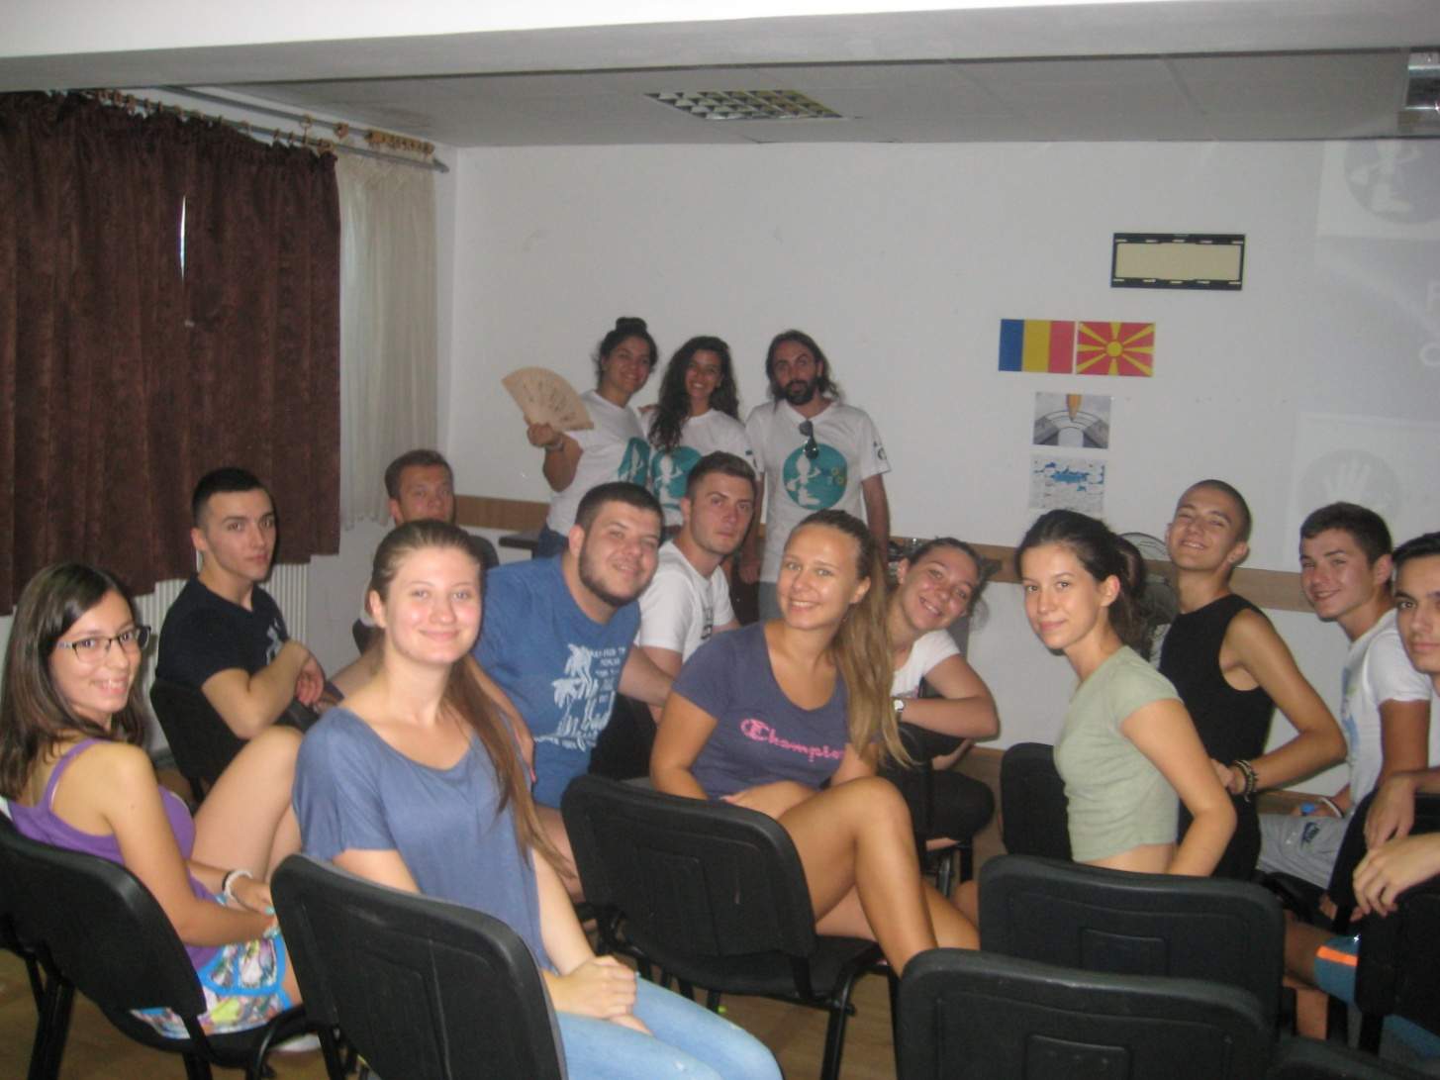
+ERASMUS, EVS and SHOE BOX PROJECTS PRESENTATIONS

Slide 4
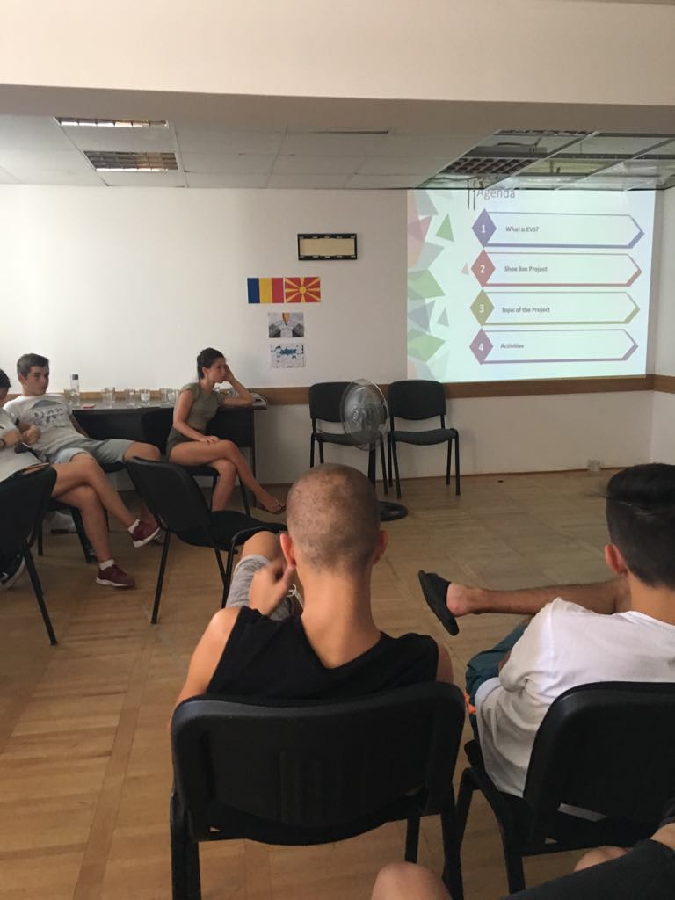
+ERASMUS, EVS and SHOE BOX PROJECTS PRESENTATIONS
We talked with together. What is EVS? Who can do EVS? How long can be EVS?
We described our project. What is the our project topic? Which do we do activity? Whom with do we working together?
Also we talked about how voluntary life. Then we answered the their questions .

Slide 5
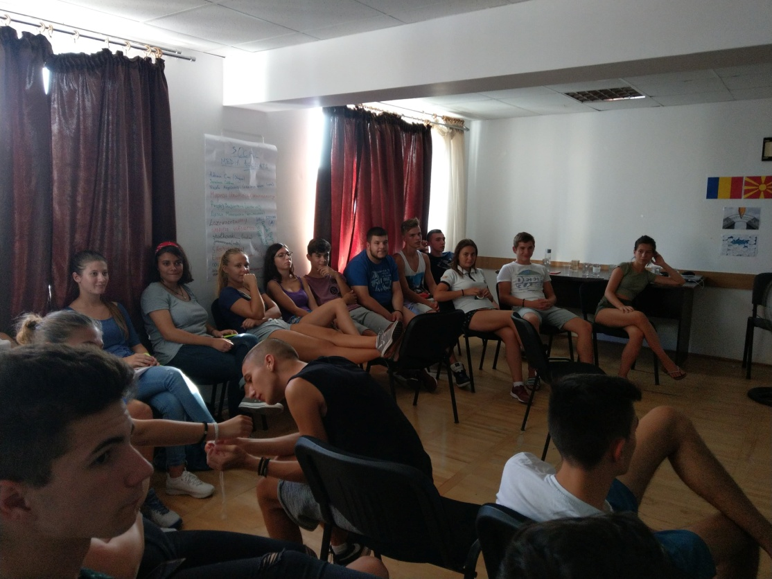
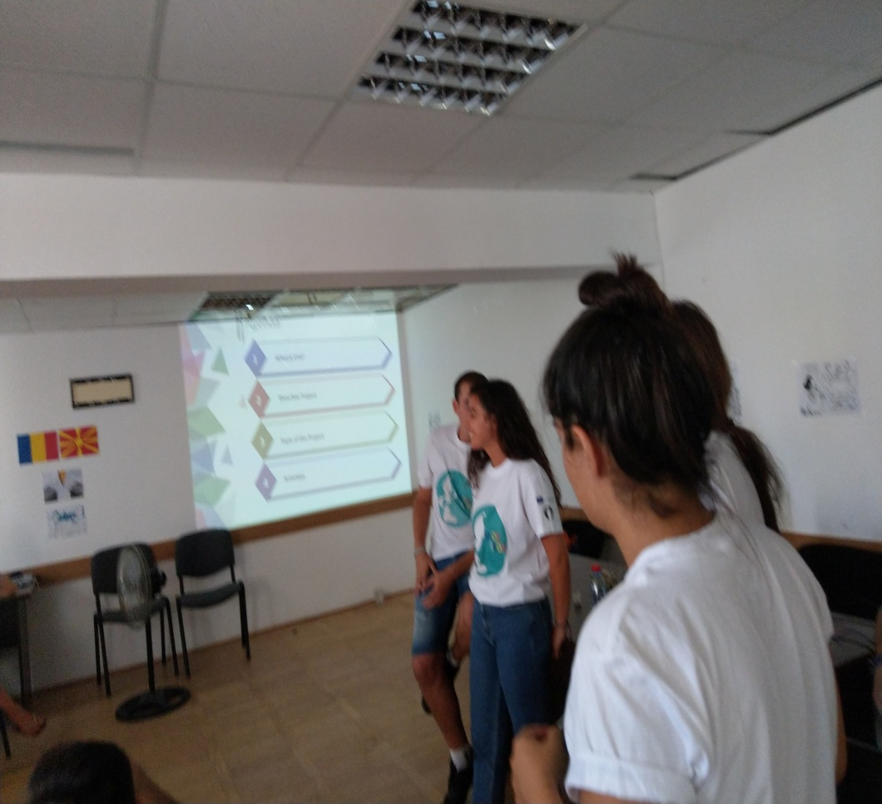
+ERASMUS, EVS PROJECTS PRESENTATIONS

Slide 6
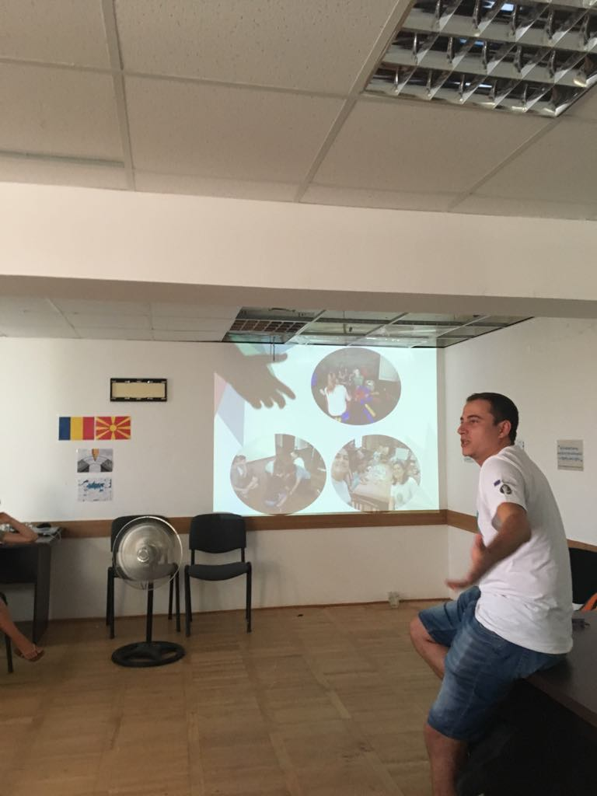
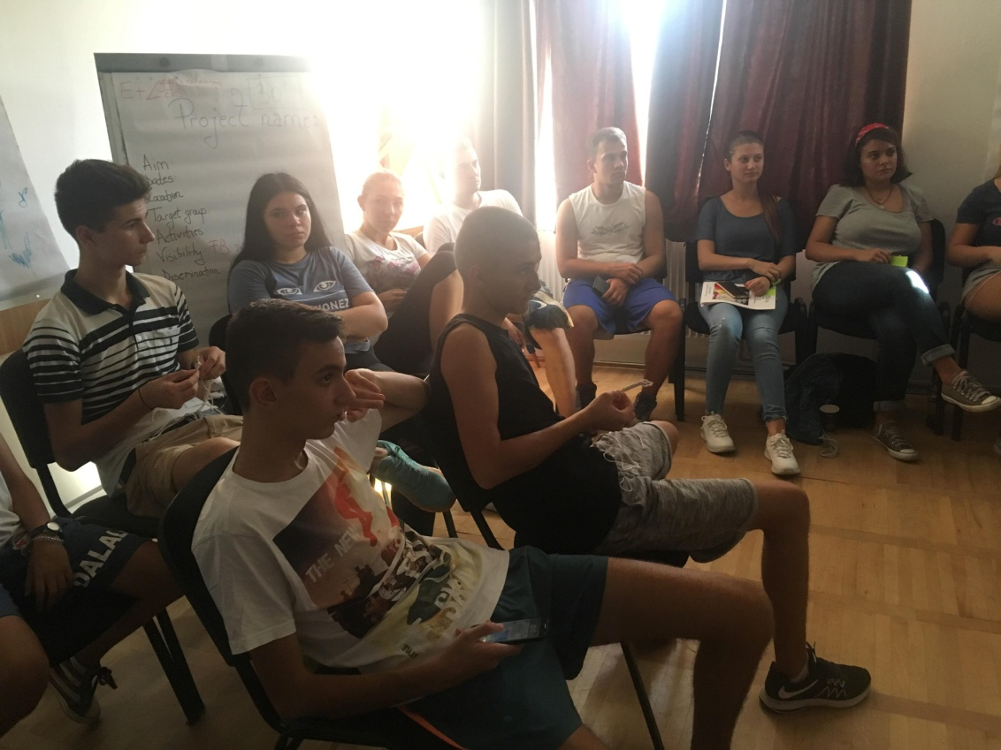
SHOE BOX PROJECTS PRESENTATIONS

Slide 7
VIDEO FORUM
PARADA -Forgotten children of Bucharest

Slide 8
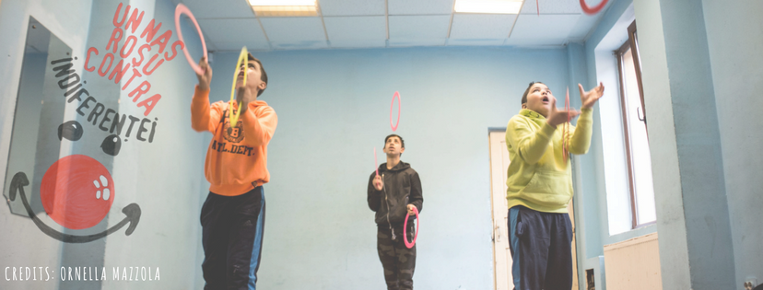
PARADA-Forgotten Children of Bucharest
PARADA
In 1996, the Franco-Algerian clown Miloud Oukili created the Parada Foundation. Its work focuses on the reintegration of children living in the street in Bucharest, Romania, especially by means of organizing a social circus.
Work with children living in the street, to rebuild their will to live, to leave the margin of society, and to socially integrate. This is done by appealing to their artistic ability and by making use of their own resources.
Two splendid reports about the street children in Bucharest, about Miloud and the PARADA Foundation, about the magic of the social circle, the social street intervention, about the victims' children and responsibilities.

Slide 9
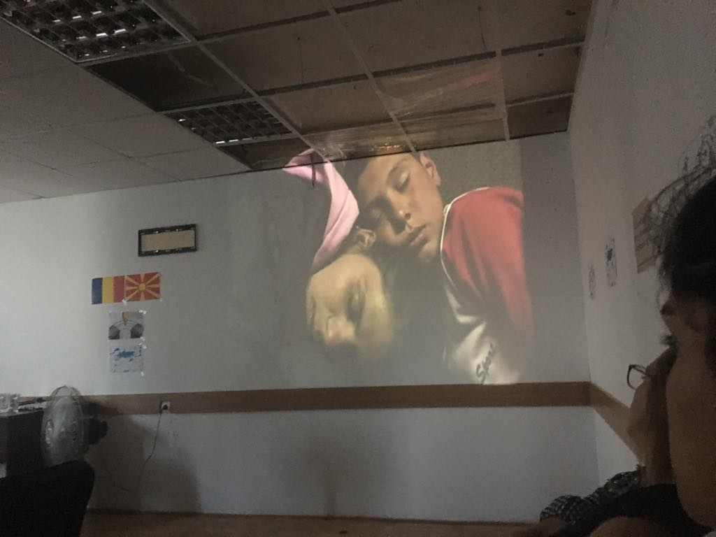
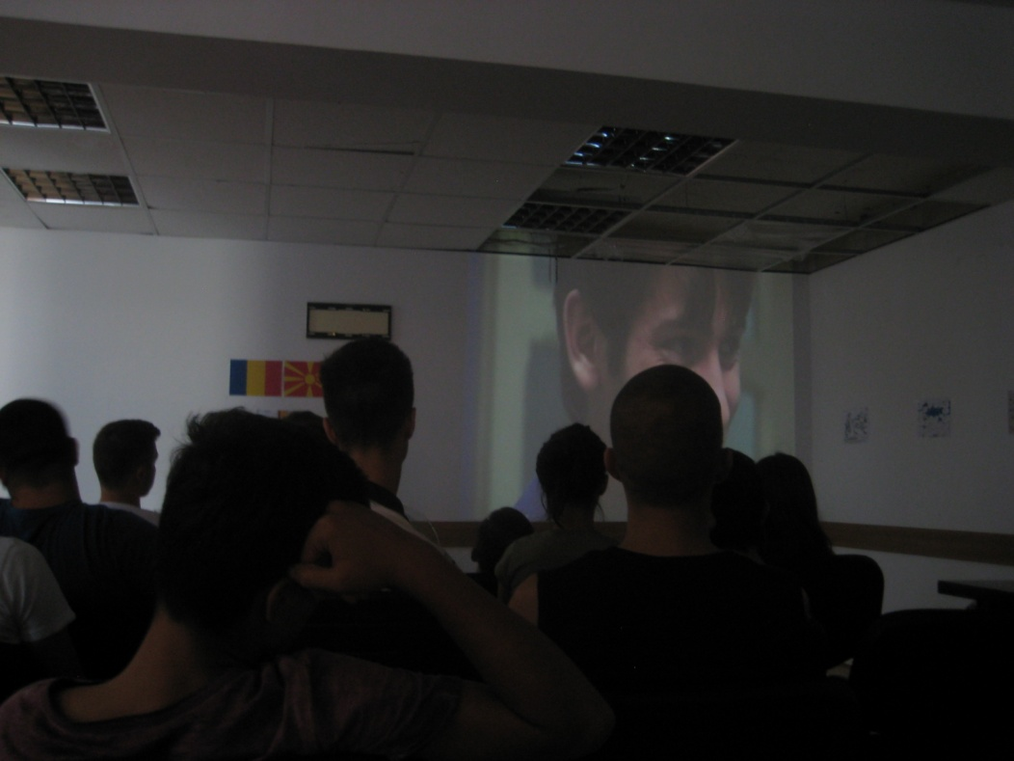
VIDEO FORUM WITH YOUTH EXCHANGE

Slide 10
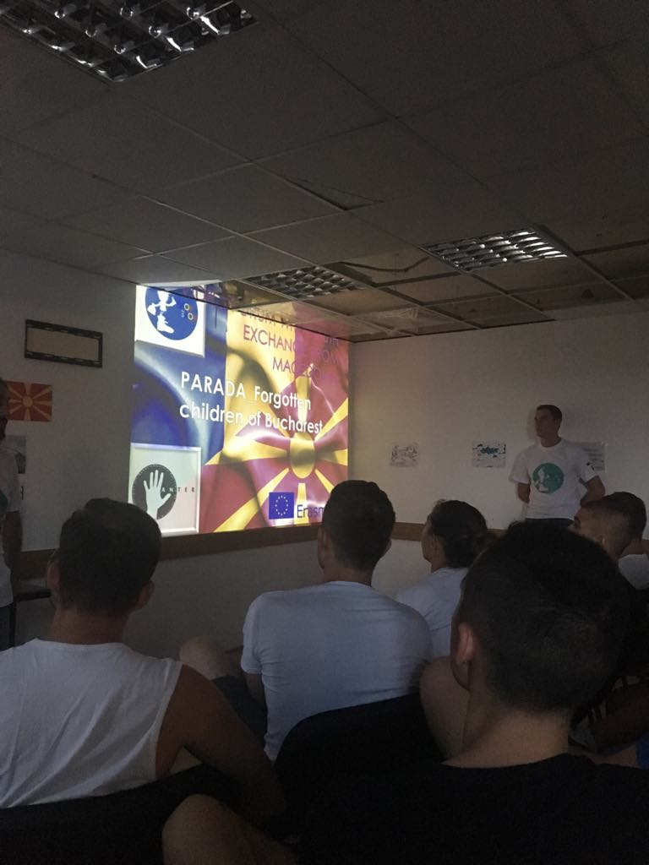
DEBATE AFTER THE DOCUMENTARY
After viewing the documentary we started the debate about the problematic of the children rights.
We asked what they were influenced by the documentary. What they think about the children's rights and we talked about what we should do.

Slide 11
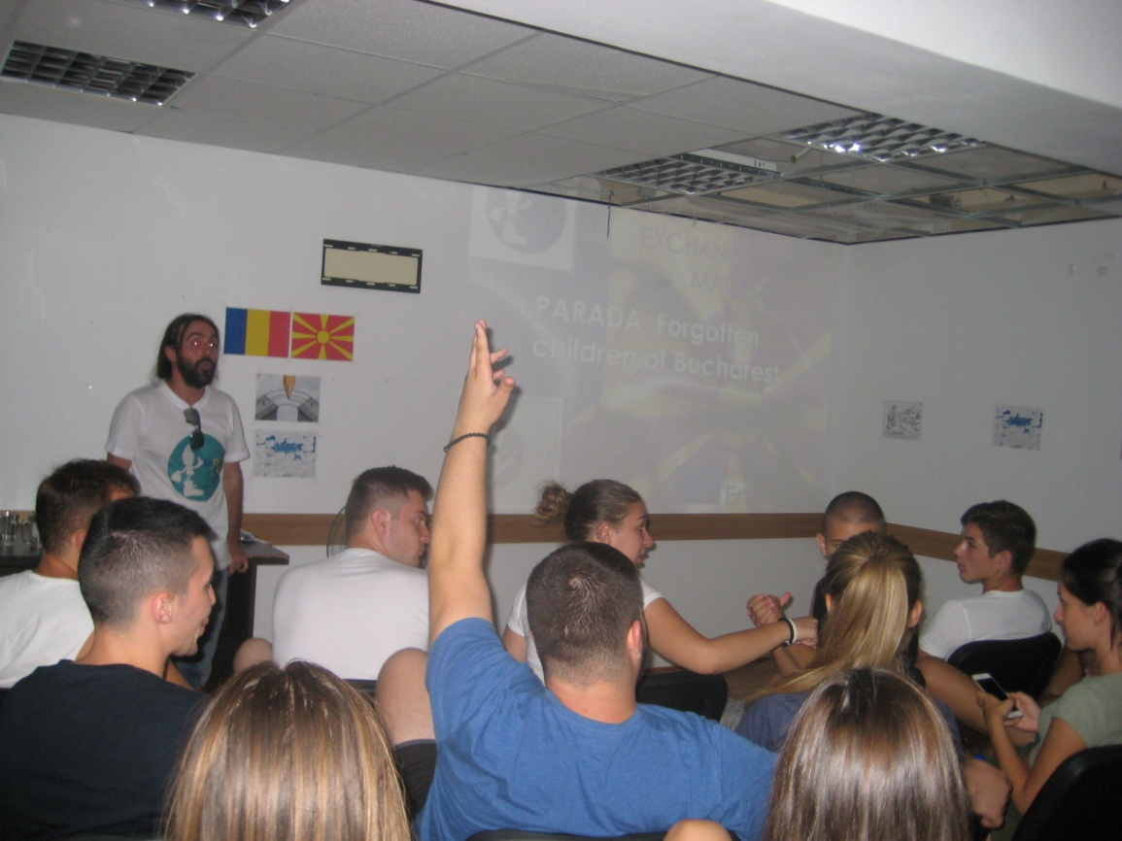
DEBATE AFTER THE DOCUMENTARY

Slide 12
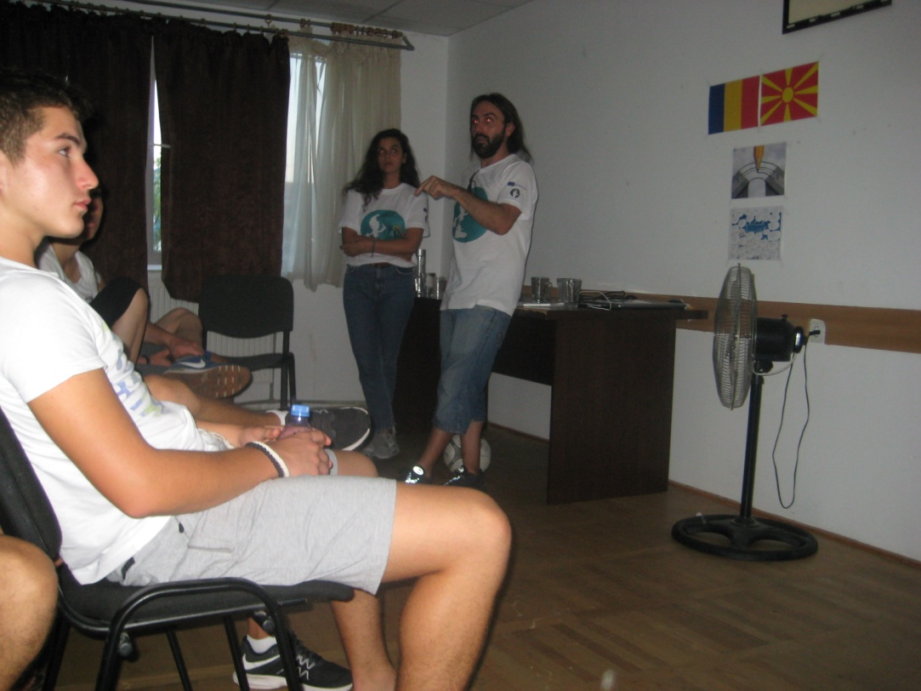
DEBATE AFTER THE DOCUMENTARY

Slide 13
THANK YOU!

