Slide 1
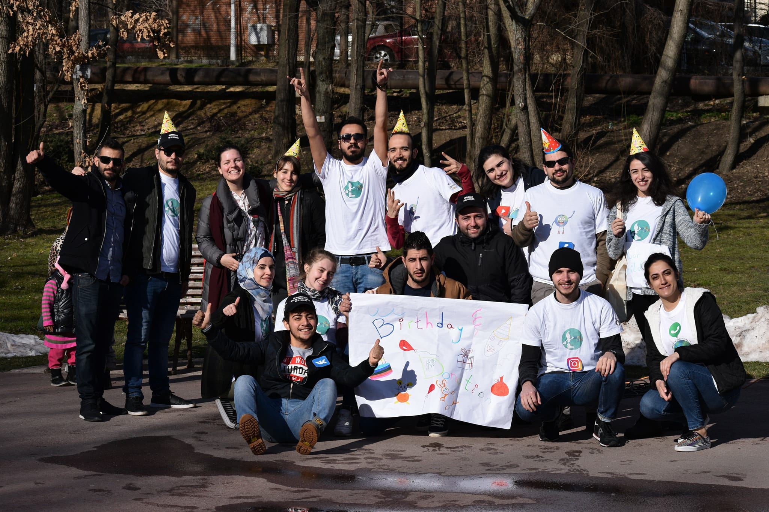
PHOTO REPORTAGE SHOEBOX
Silent Action for Birthday Donation

Slide 2
Preparation for silent action

Slide 3
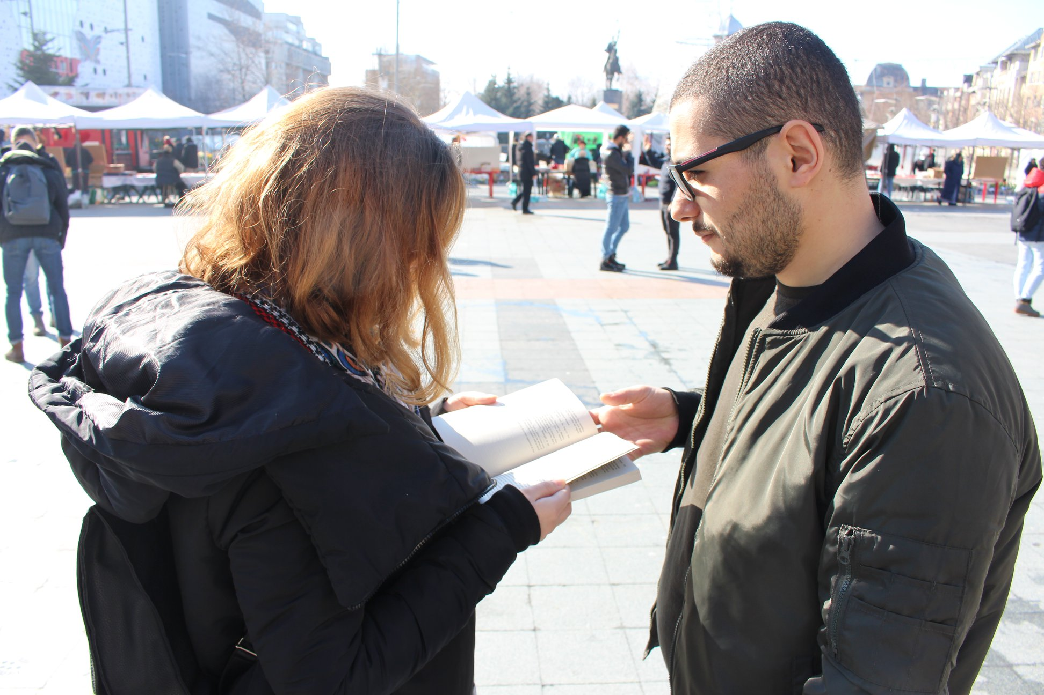
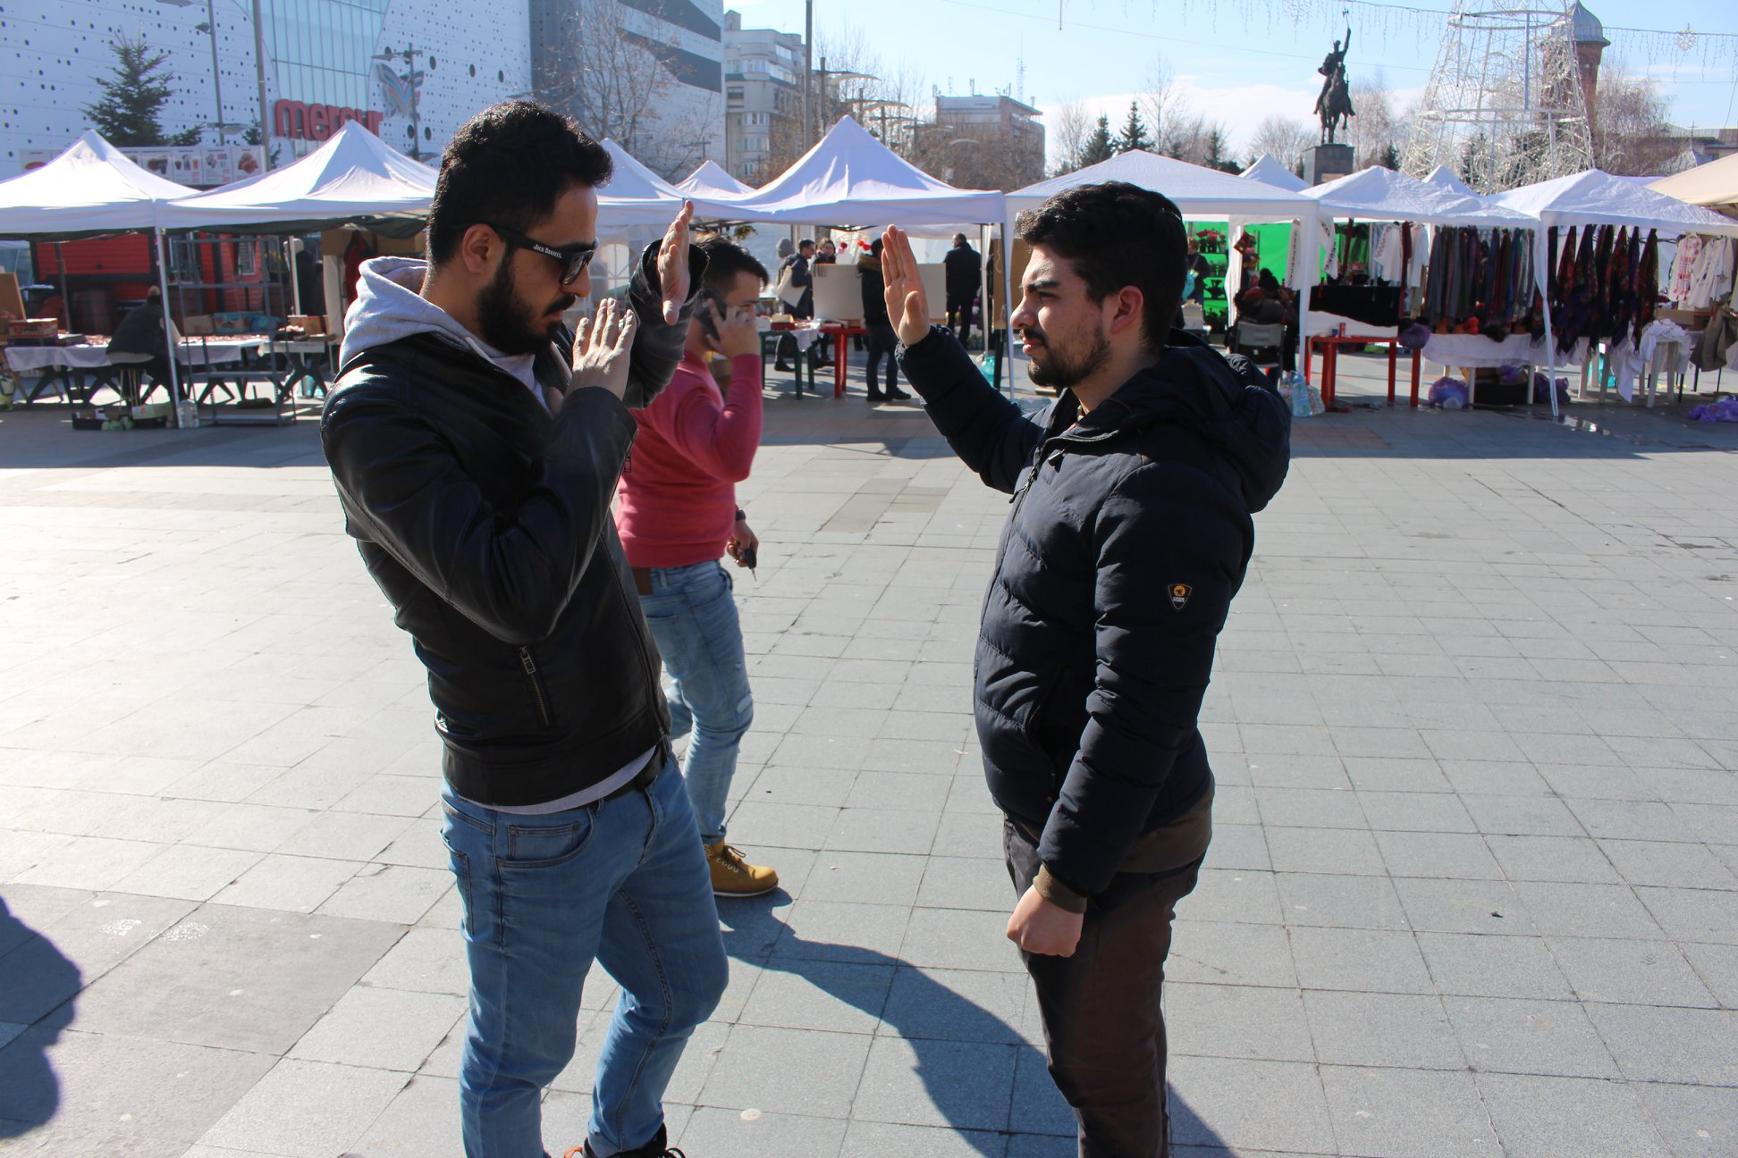
Silent Action for Children’s Right

Slide 4
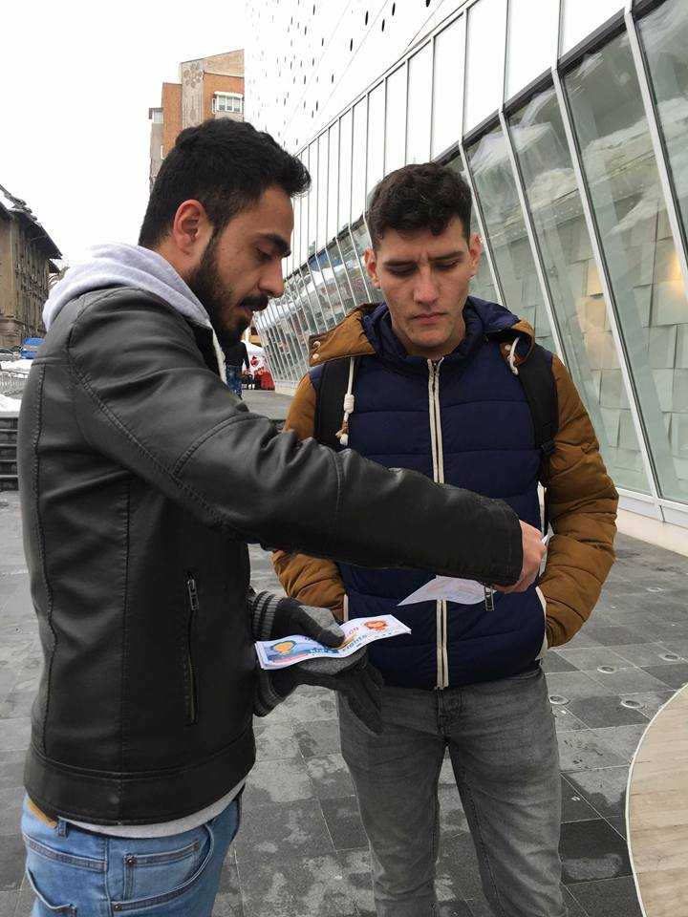
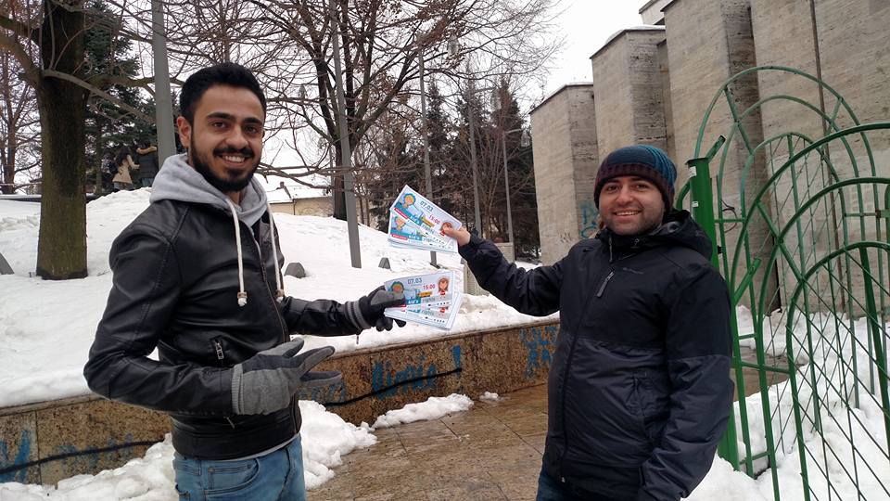
Promote Silent Action Events

Slide 5
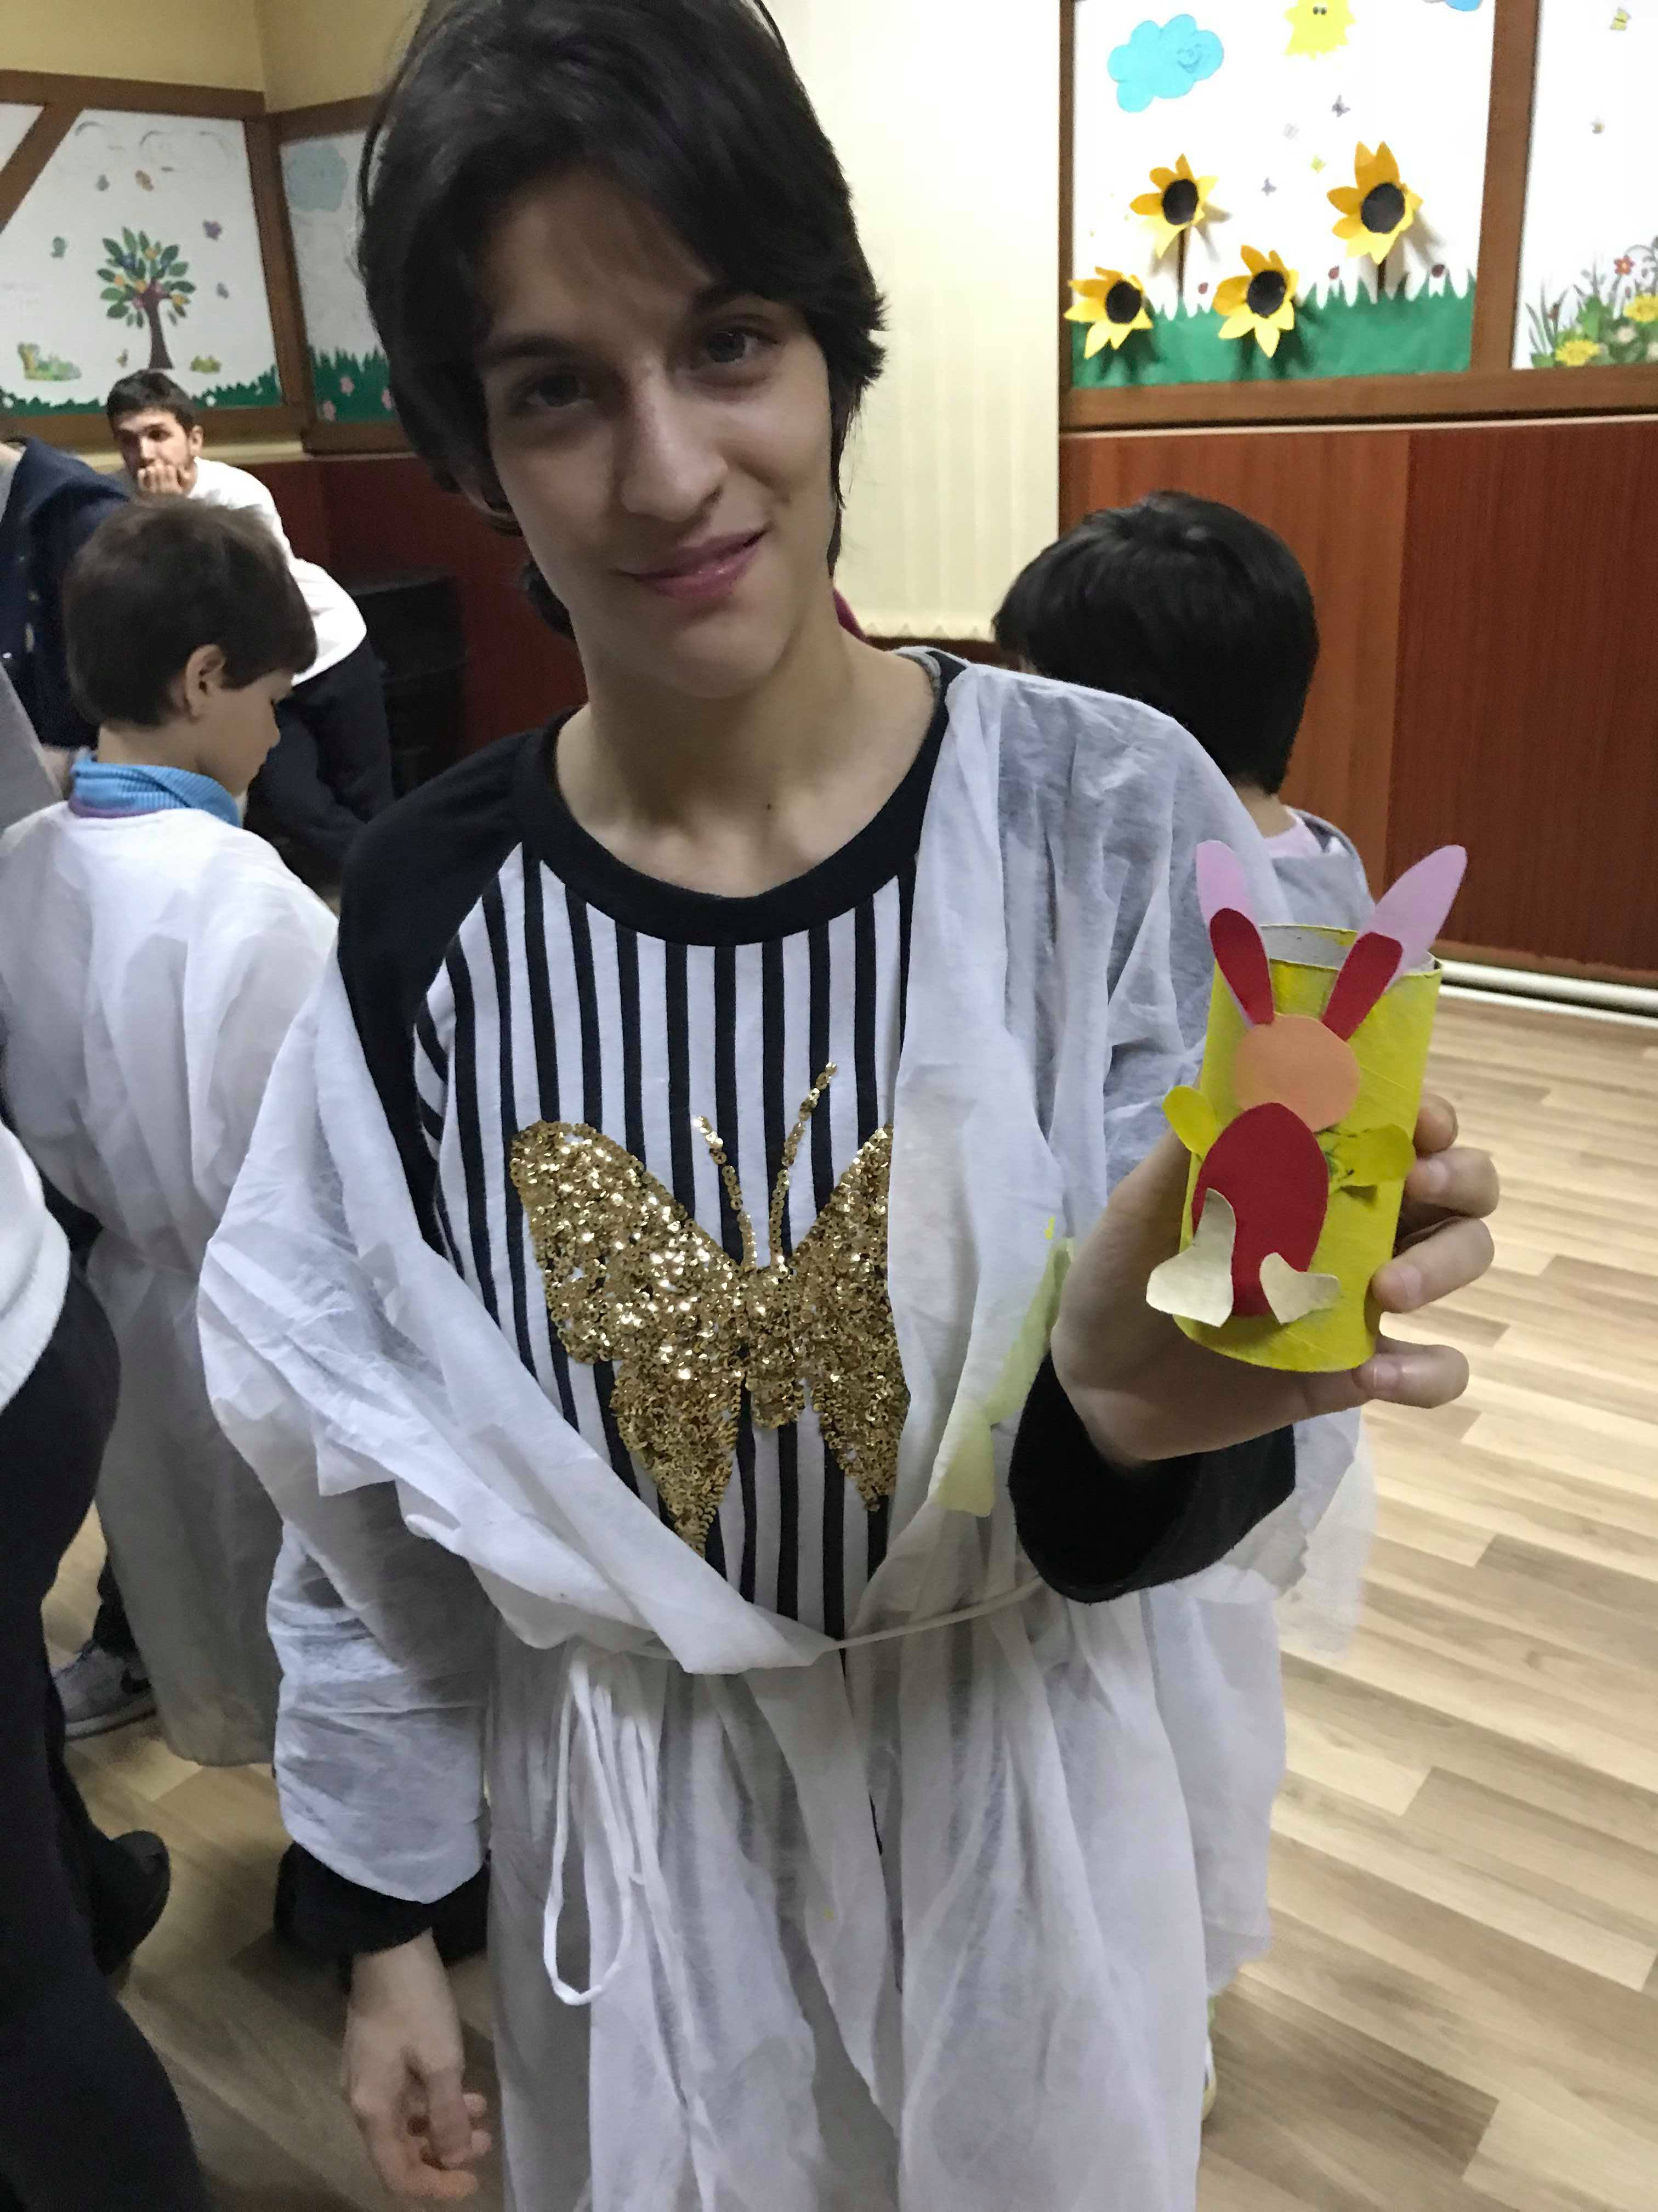
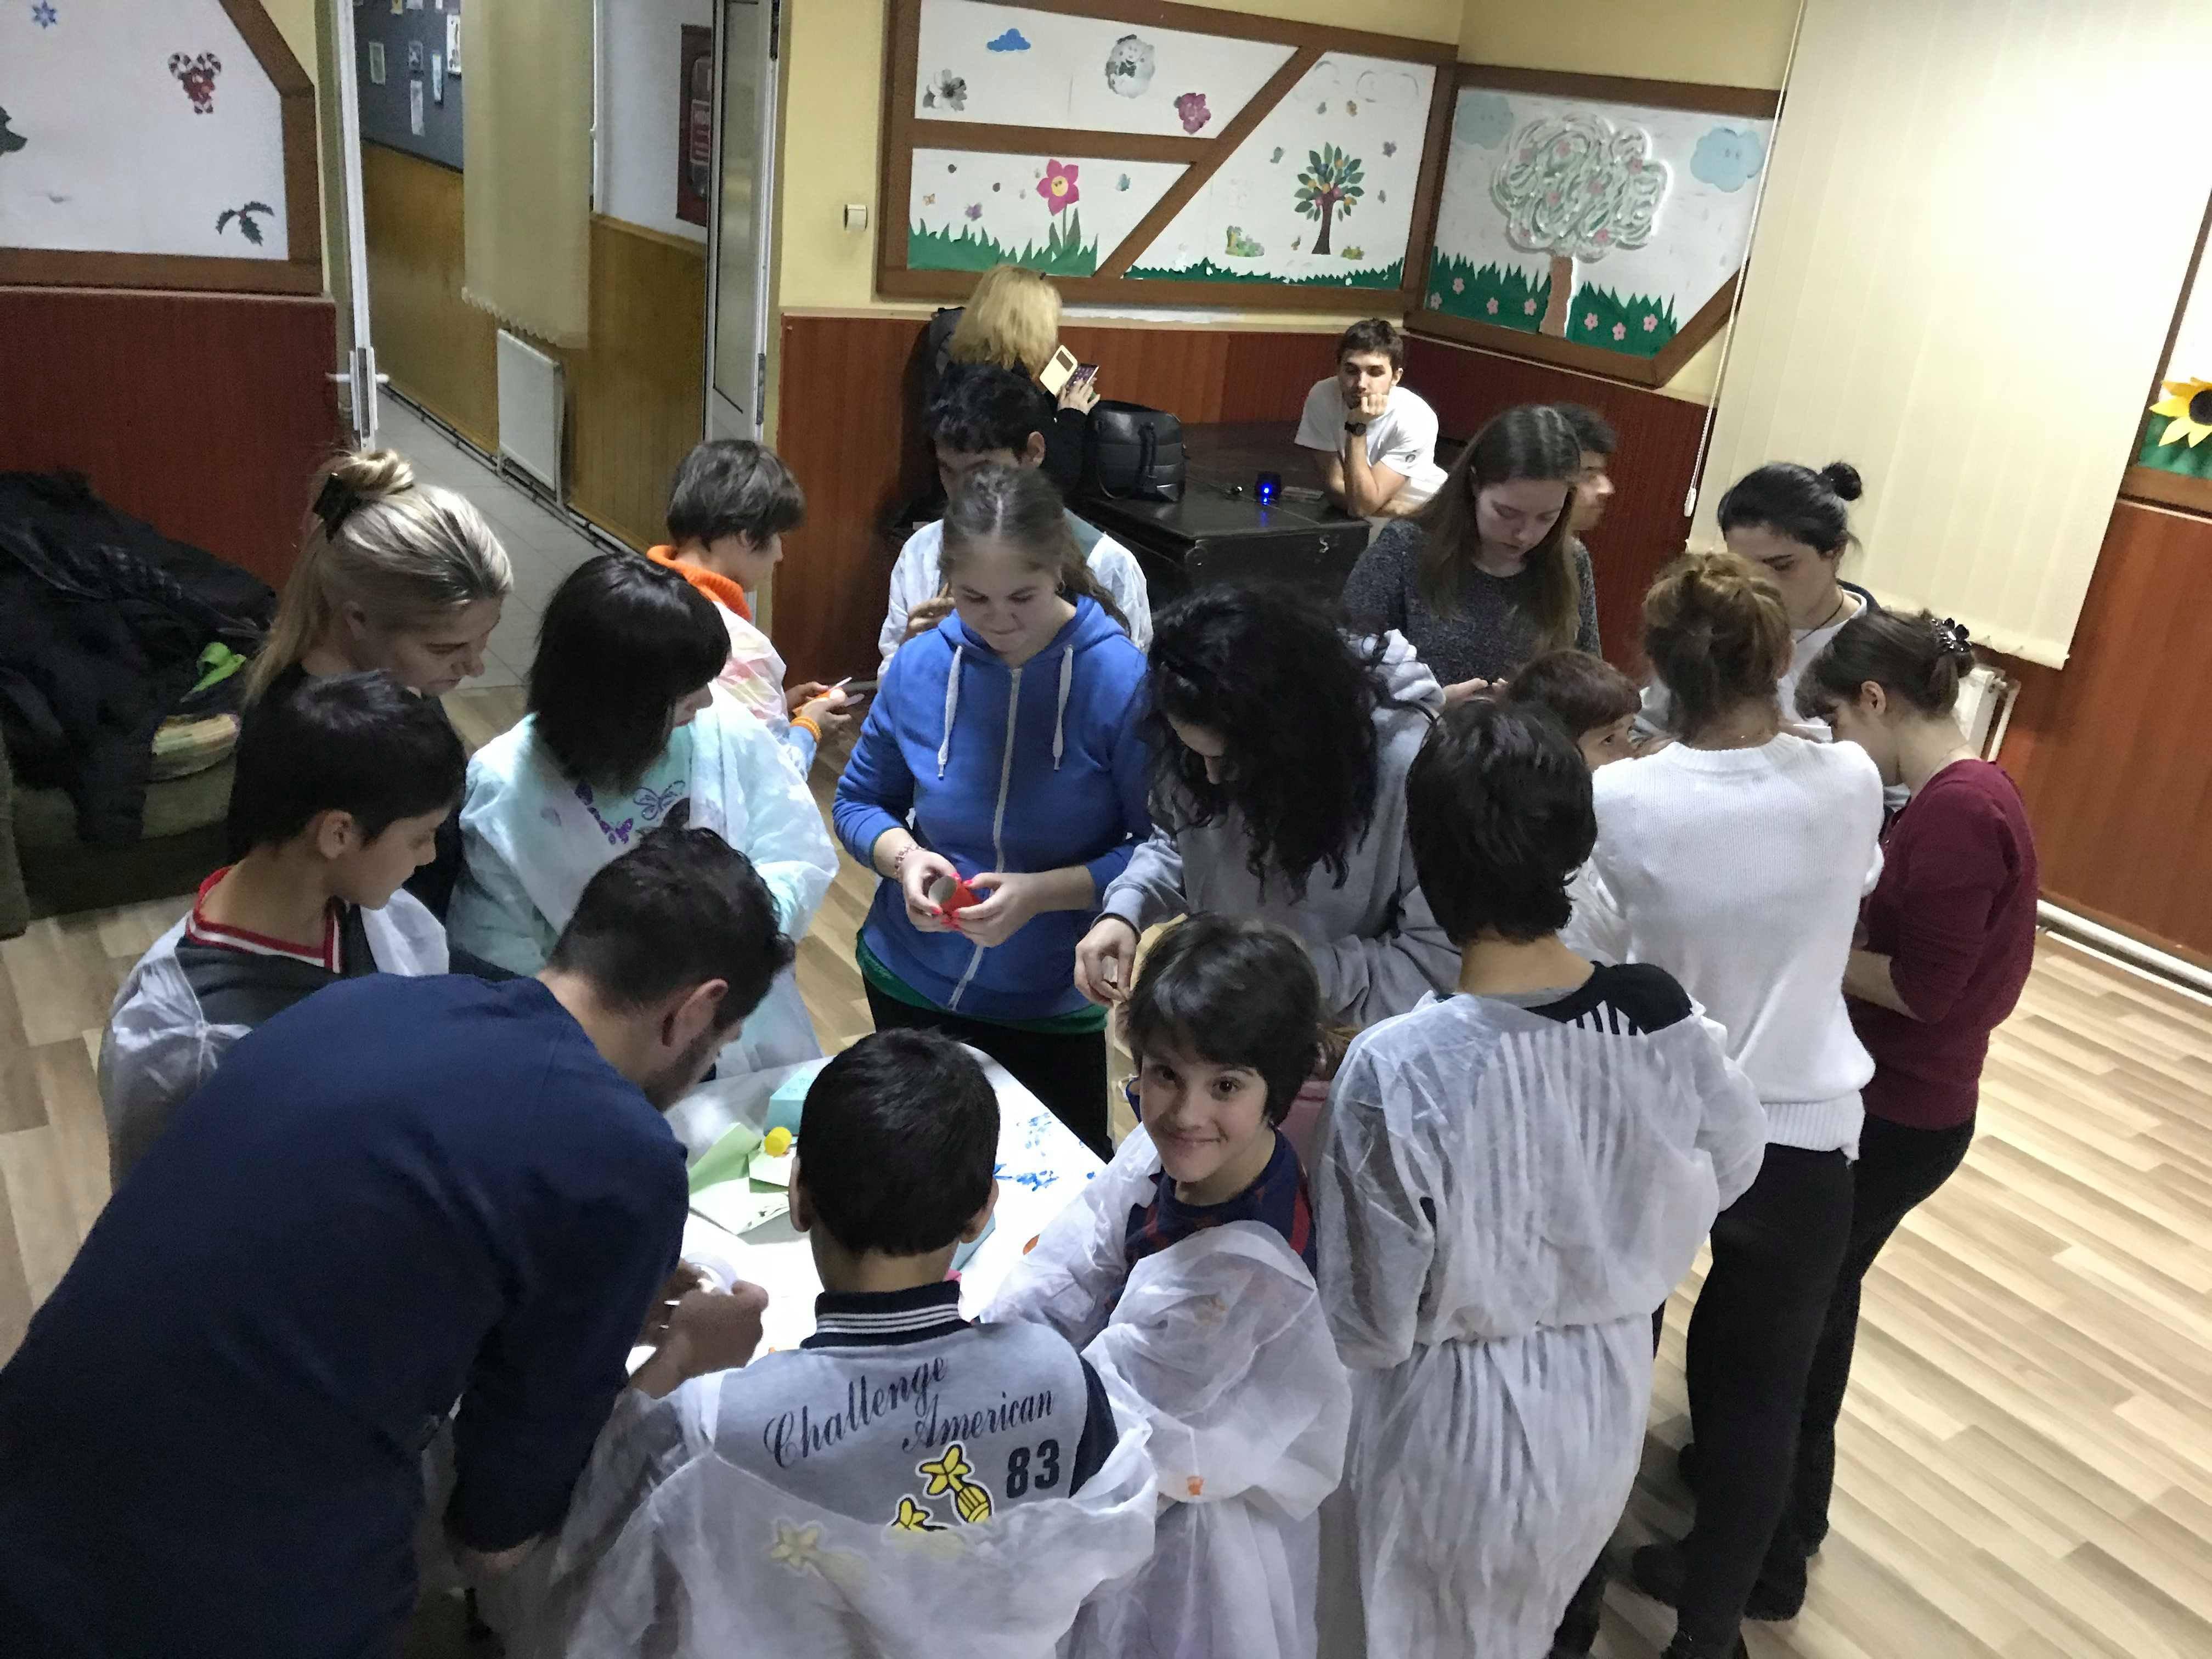
We playing, dancing together with kids at SF Mina School

Slide 6
We shared the stuff that we collect by donation campaign

Slide 7
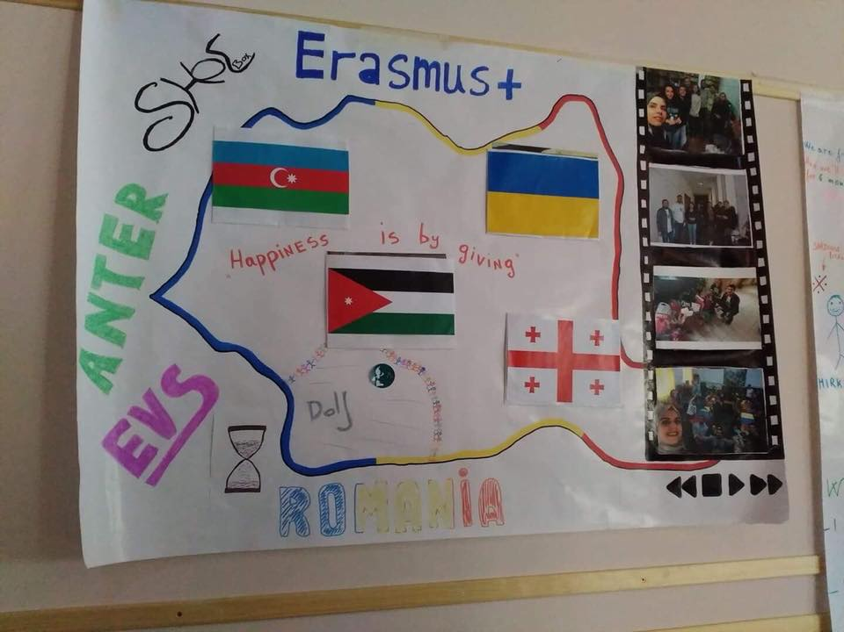
We represent SHOEBOX at OAT

Slide 8
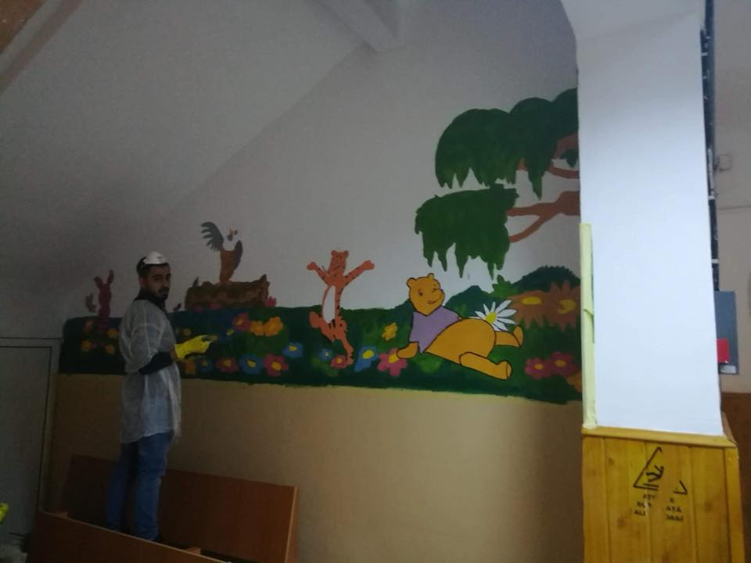
Paint the wall at SF Mina School

Slide 9
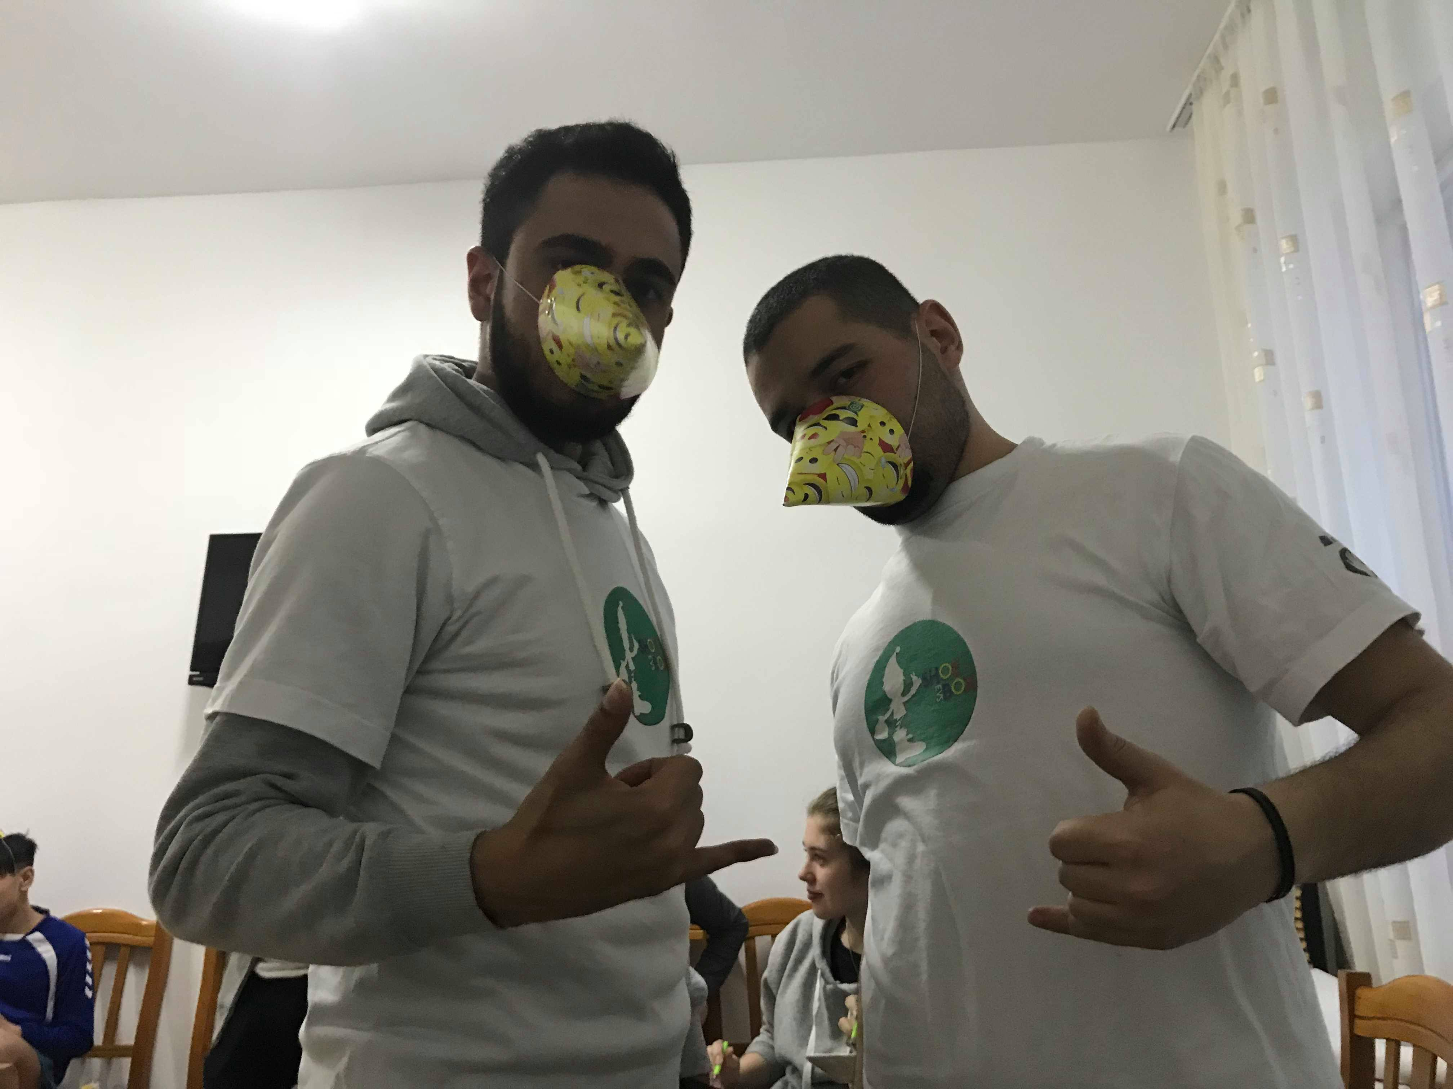
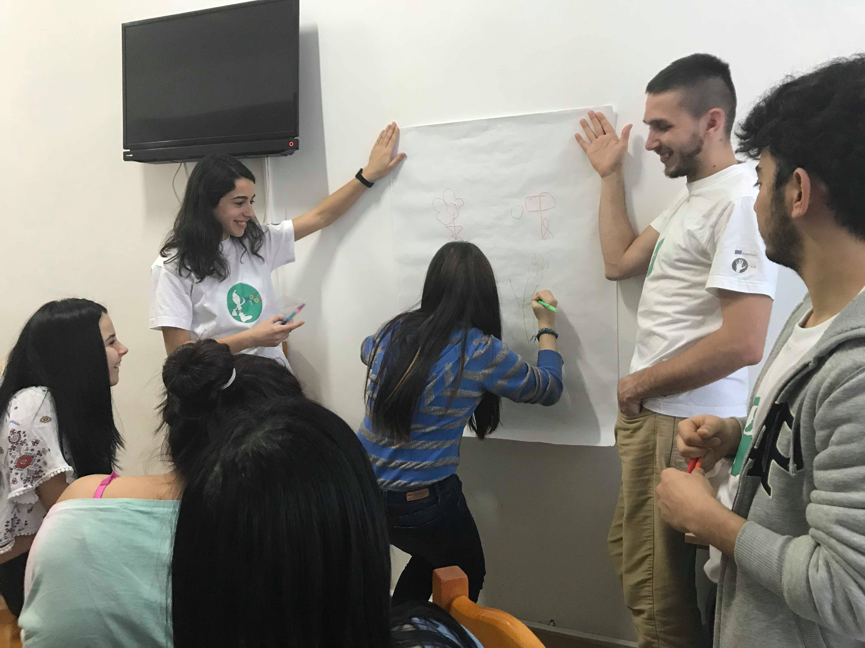
Our 1st birthday donation

Slide 10
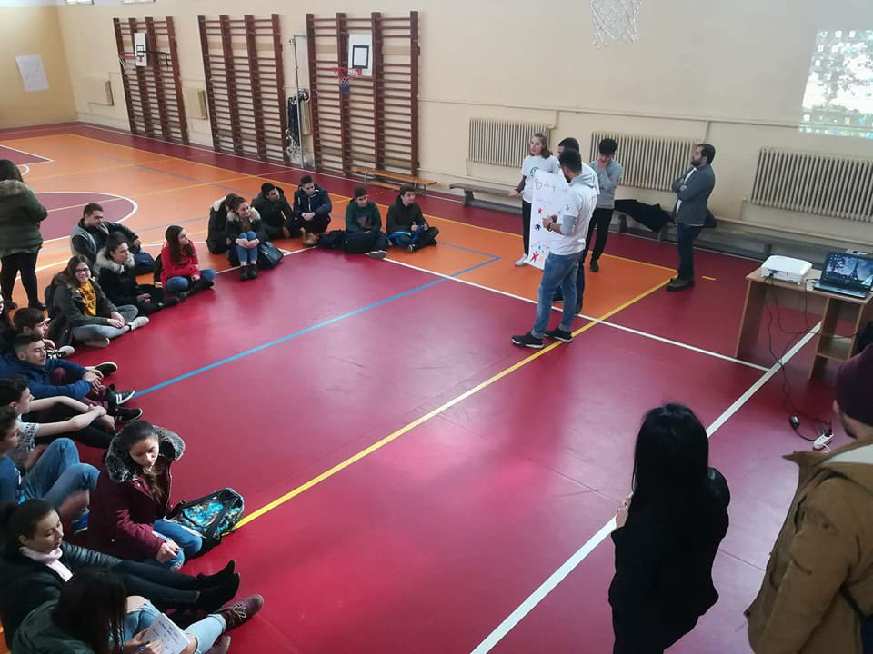
Presentation about the idea of donation at Stefan Odobleja high school

Slide 11
Who said mentorship session is boring? “SHOEBOX Team” know how to enjoy the moment ;)

Slide 12
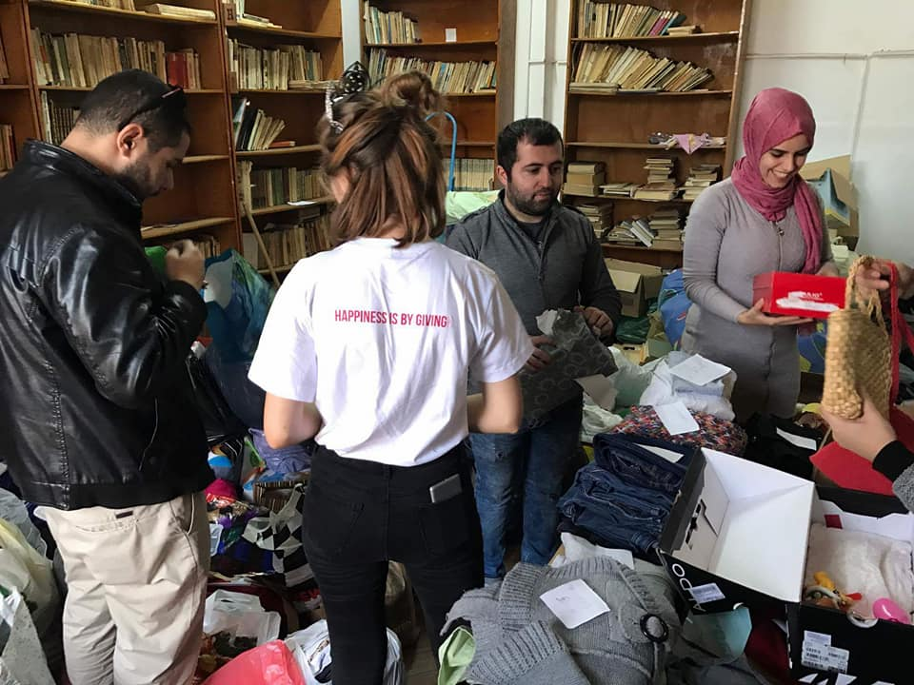
Sorting process of donation stuffs

Slide 13
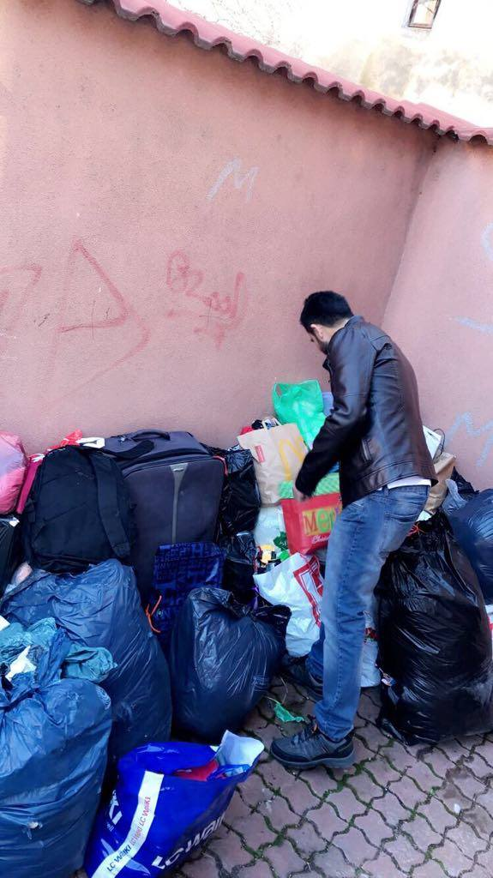
Just a bit of our collection

Slide 14
Celebrate the Christmas Eve with our organization ANTER

Slide 15
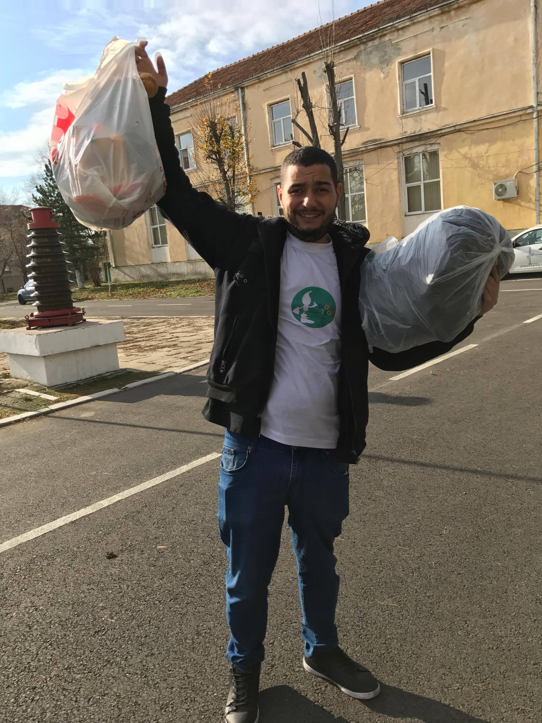
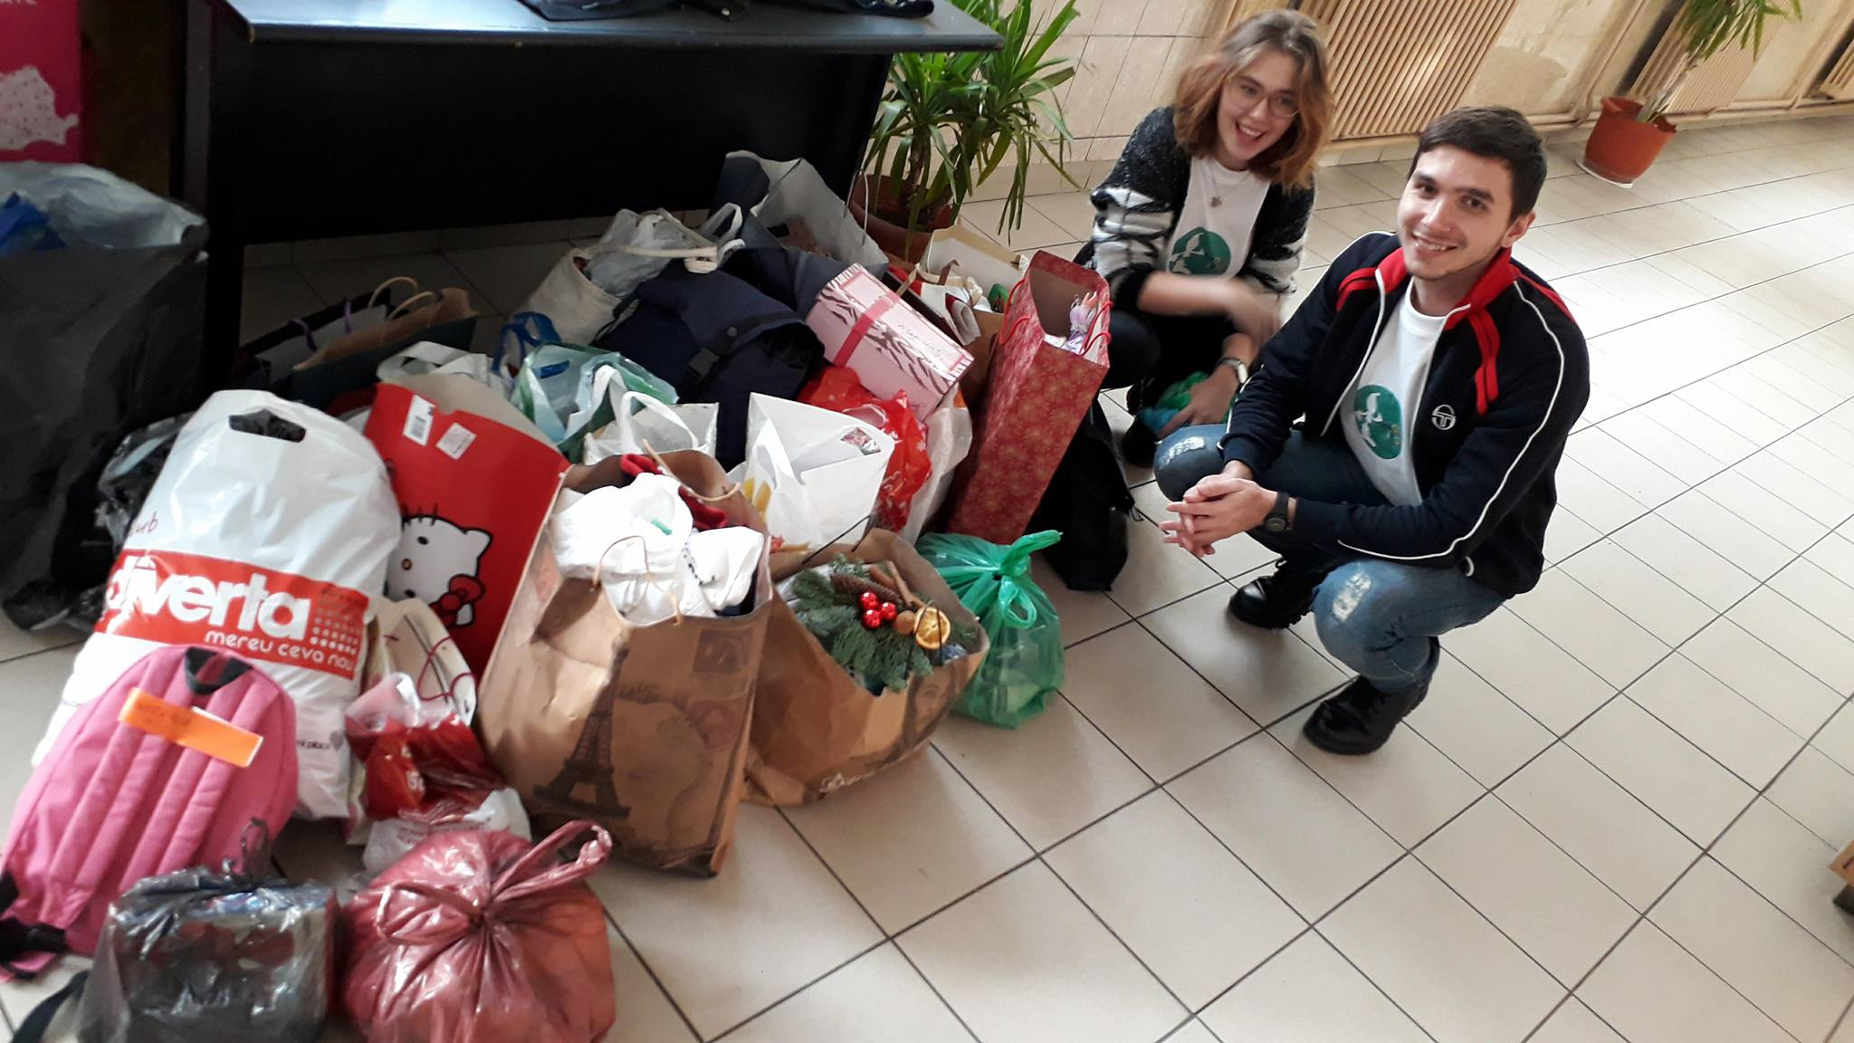
Promote donation campaign in schools

Slide 16
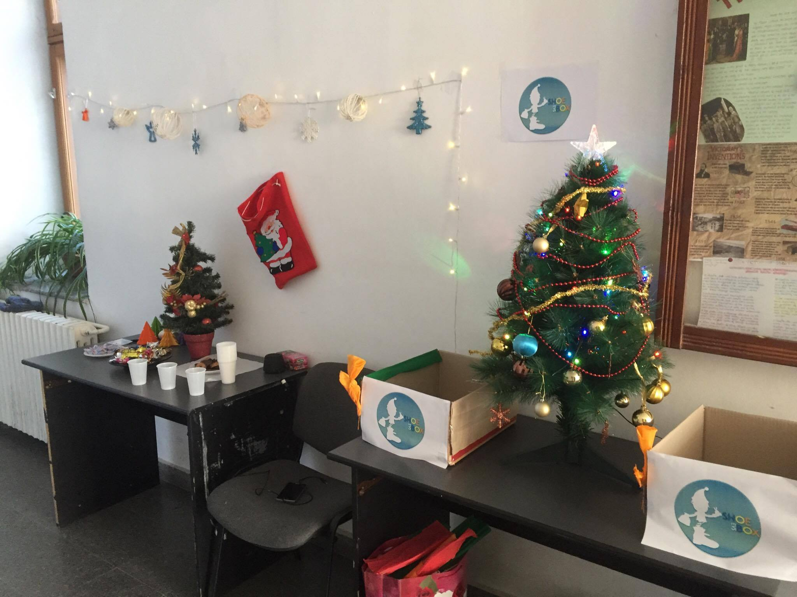
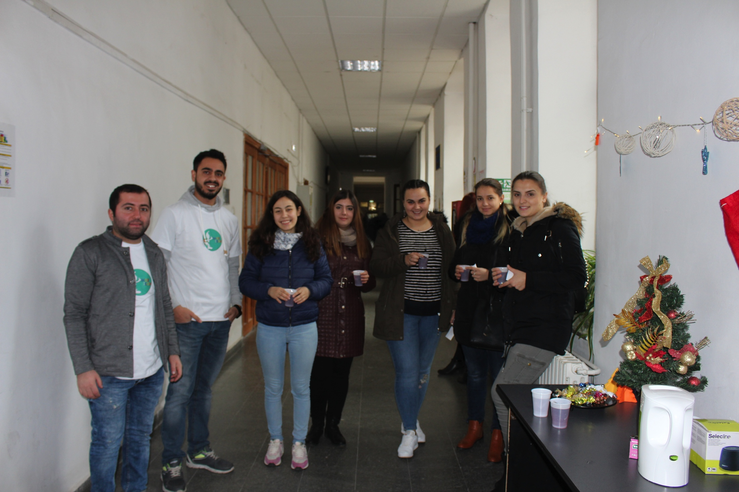
Promote donation campaign in Craiova University

Slide 17
Preparation for university and school campaigns

Slide 18
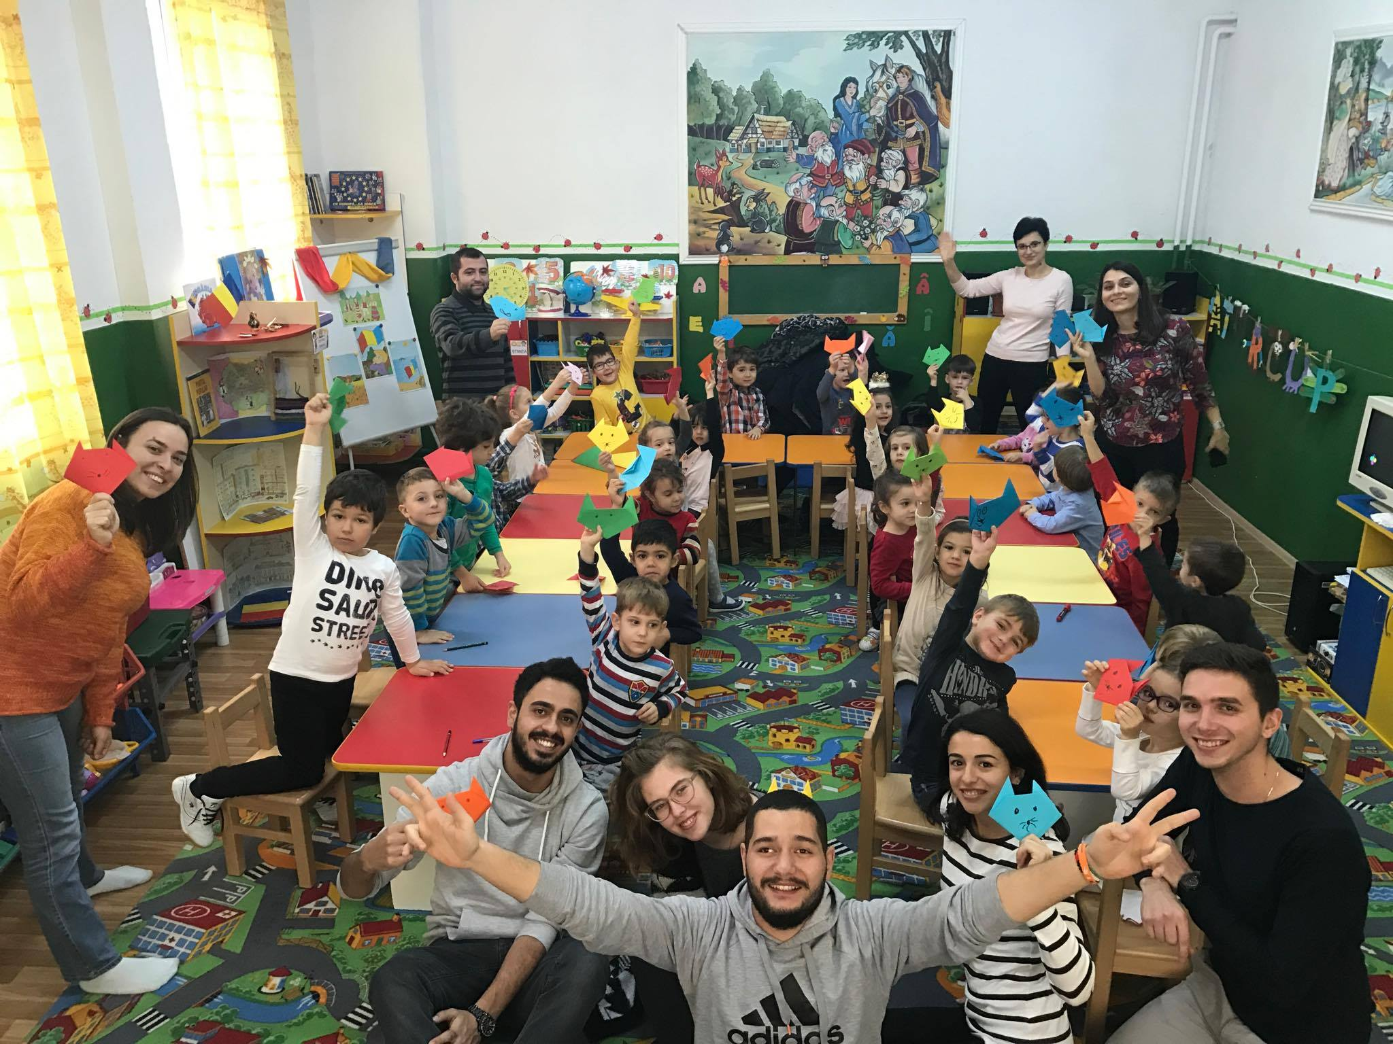
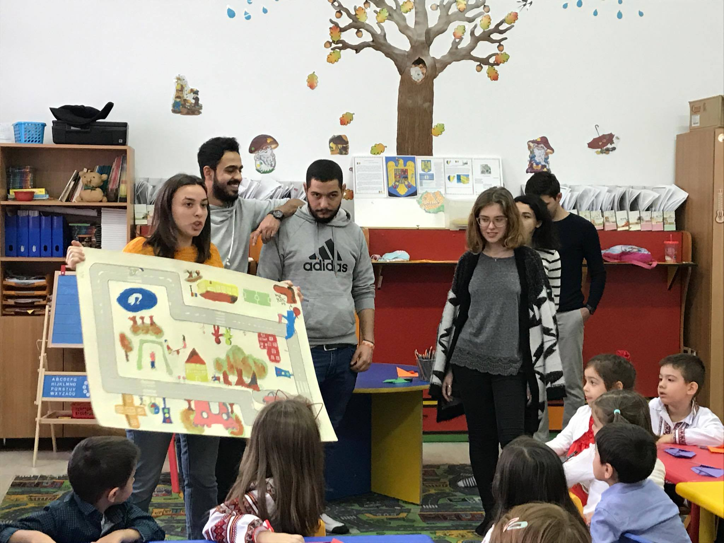
We had fun together at kindergarten

Slide 19
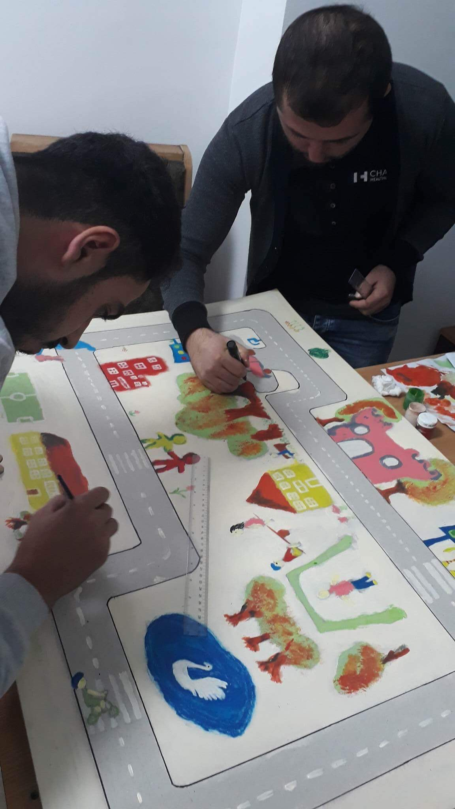
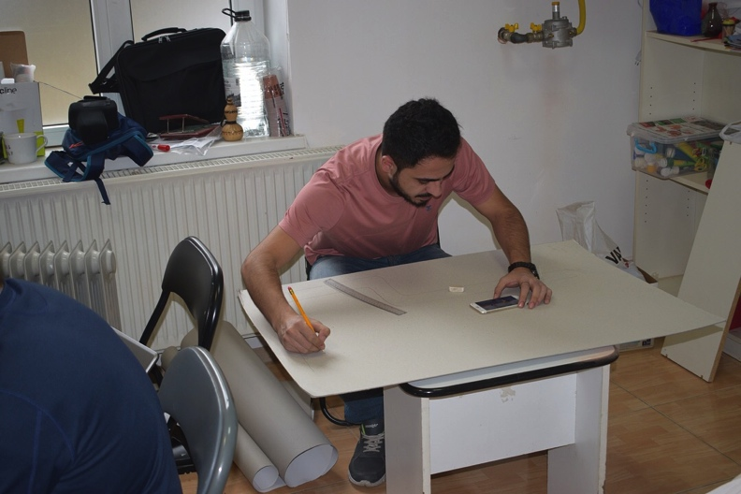
Getting ready for children

Slide 20
HERE WE ARE “SHOEBOX” TEAM happiness is by giving

