Slide 1
EVENT WITH COANDA HIGH SCHOOL
CHILDREN’S RIGHT’S

Slide 2
Agenda
What is EVS?
What is Shoe Box Project?
Our Activities About the Children Right
8 Fundamental Children’s Right’s
Children’s Right’s in the World
Children’s Right’s in Romania
At 9th on October we had a presentations about the ‘Children's Rights’
Your could see the agenda here.

Slide 3
This activity allows young people age 17-30 to express
their personal commitment through
unpaid and full-time
voluntary service for up to 12 months
in another country
within or outside the European Union
In EVS you will get the change to live
in other country get to know new cuture
new language
In EVS you will get the chance to live
in another country
Developing public actions to collect
toys/school supplies/hygiene items/clothes for children
and youth people from Craiova Dolj county that are in difficulty.
Developing public actions to promote children’s Rights among the parents, emphasizing
the.
Developing actions called «Birthday donations».
EVS
Shoe Box
Notes:
NOT: Bu slayttaki resimleri değiştirmek için, resmi seçin ve silin. Sonra, kendi resminizi eklemek için yer tutucudaki Resim Ekle simgesine tıklayın.

Slide 4
We interviewed the people of Romania about children's rights. We asked them 'What do you know about children's rights and what should we do to protect children's rights?
According to our answers, they do not know anything about children's rights.That’s why, You should learn your own right’s
Our Activities About the 'Children Right’s
Notes:
NOT: Bu slayttaki resimleri değiştirmek için, resmi seçin ve silin. Sonra, kendi resminizi eklemek için yer tutucudaki Resim Ekle simgesine tıklayın.

Slide 5
8 Fundamental Children’s Right’s
Right to Education
Right to Health
Right to Identity
Right Life
Right to Food
Right to Freedom
Right to Protection
Right to Water

Slide 6
CHILDREN’S RIGHT’S PRESENTATION

Slide 7
We played a game. We wanted to them to write objects and emotions. This object and emotion should pair.

Slide 8
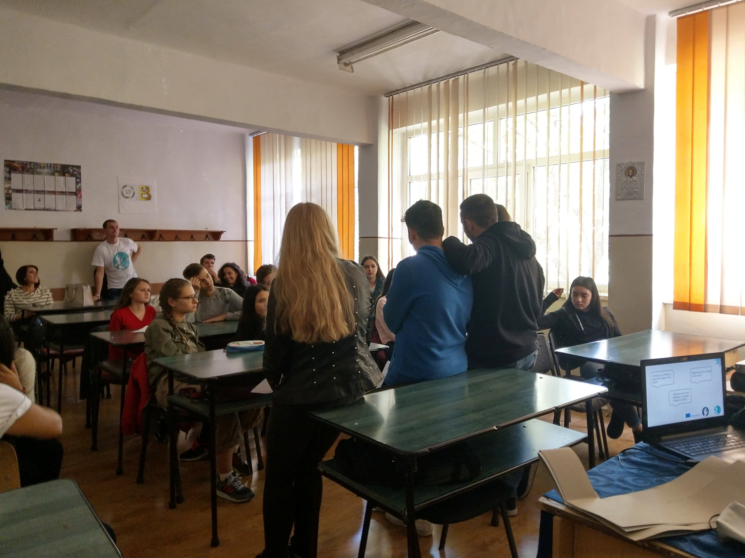
They presanted own the result

Slide 9
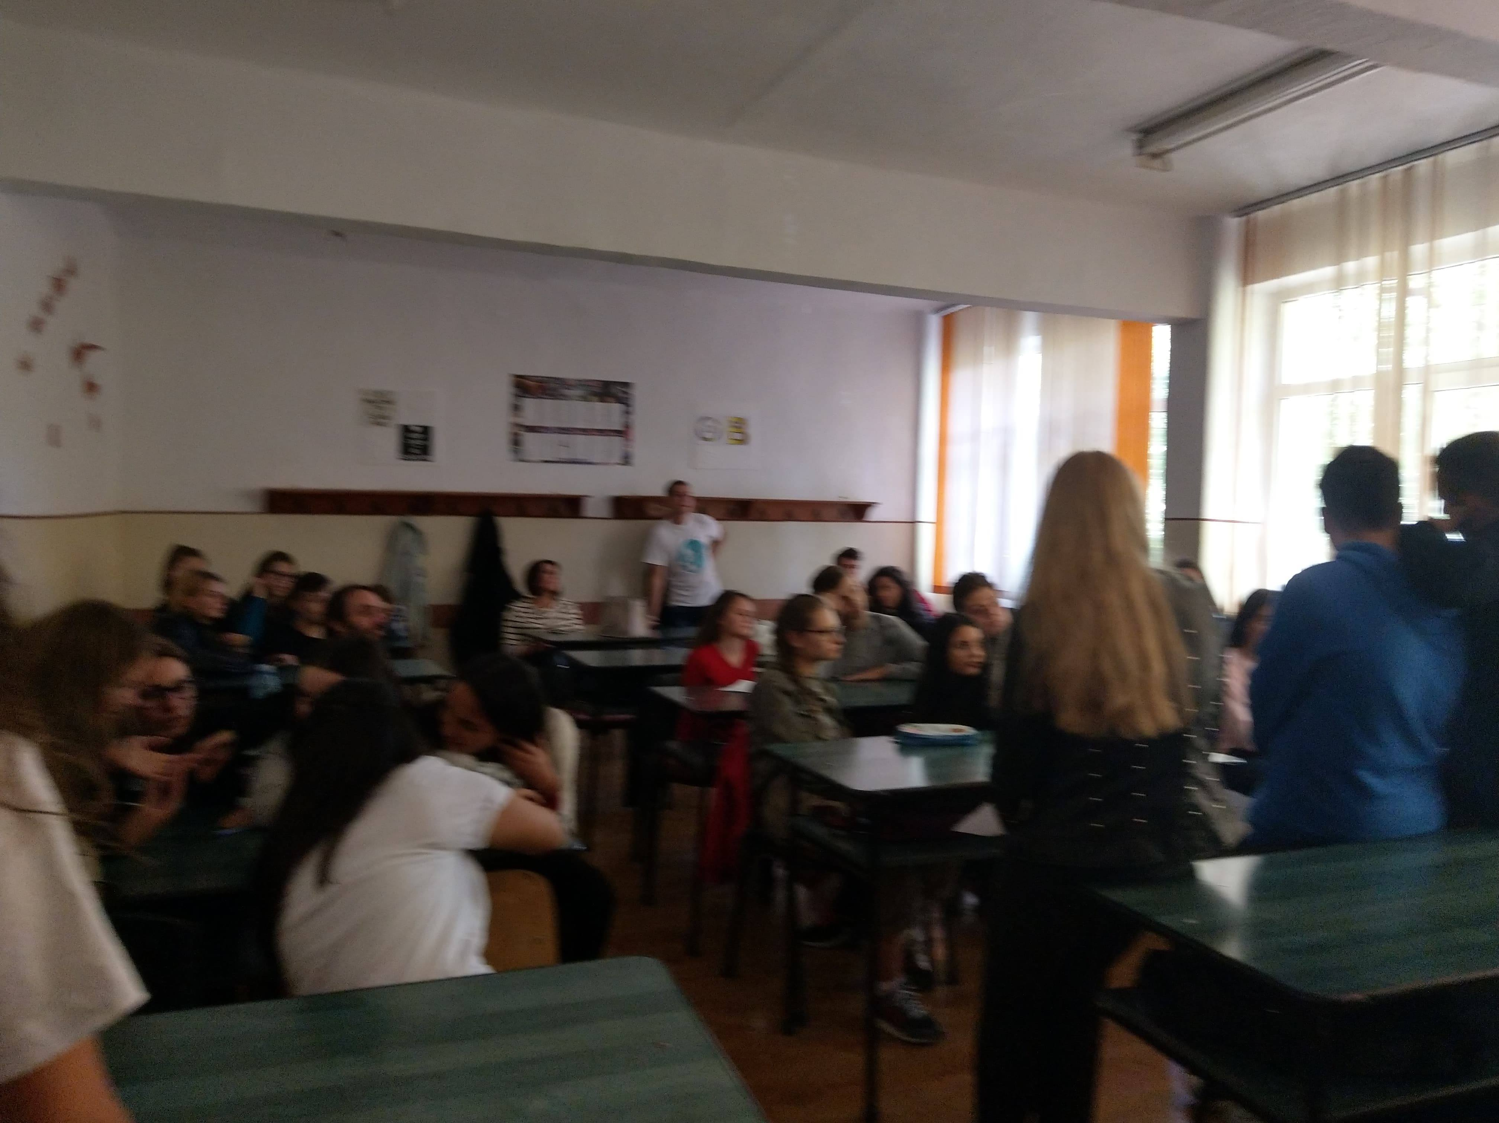
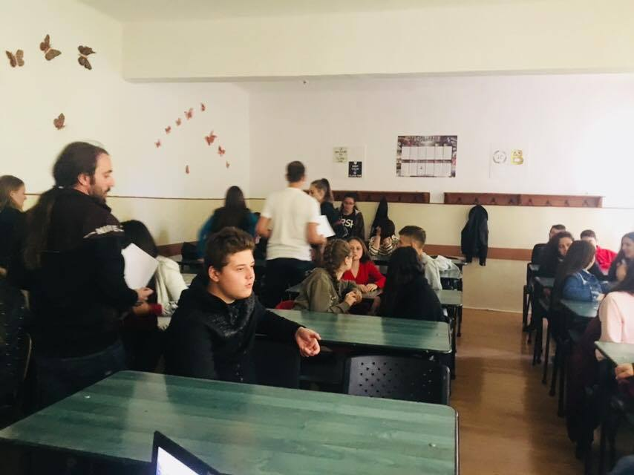
CHILDREN’S RIGHT’S PRESENTATION

Slide 10
After presentation, we met the some question
What do you thinking
about the rights of the
child?
What was the most
affecting you about
children's rights?

Slide 11
THANK YOU

